Slide 1

Office of Information Practices UIPA Record Request Log Basic Training
Hawaii’s Public Records Law
Chapter 92F, HRS
Notes:
(June 2016)
Welcome and thank you for taking the time to learn how to use the UIPA Record Request Log, designed by the state Office of Information Practices (OIP) to track and report on formal written requests for public records, which are made under the Uniform Information Practices Act, (UIPA), which is found at HRS Chapter 92F.
Before I start, please be aware that the complete written transcript of this training is available on the “Notes” page of the power point presentation posted on OIP’s Training page at oip.hawaii.gov, where the Log form, written Instructions, Checklist, and other training materials are also located. You may wish to download the FY 2017 Sample Log, preferably in color, to reference during this training.
This power point presentation walks you through the procedures of recording data onto the UIPA Record Request Log that each agency must keep and submit to OIP. Today’s training assumes that you have basic knowledge about the UIPA’s requirements. If not, please first study OIP’s online videos and training materials about the UIPA itself at oip.hawaii.gov. We will not discuss in great detail the various exemptions from disclosure or other legal nuances of the UIPA in this training. While this presentation will explain many of the UIPA’s requirements, it is primarily for the purpose of helping you fill out the Log.

Slide 2
Knowing how to use the Log will help you to understand the UIPA process better.
Write down questions and later call OIP at 586-1400 or e-mail oip@hawaii.gov
Notes:
As OIP knows from post-training surveys, learning how to use the Log will give you a better understanding of the UIPA process. While the law itself can seem complicated, the Log walks you through the UIPA’s legal requirements so that you will know what to do when you actually receive a request at work.
With hundreds of State and County employees using the Log, this presentation is the most efficient way to provide consistent and uniform training to employees, who have different degrees of experience with the Log and the UIPA. This presentation will provide detailed instructions on how to enter Log data, while also explaining some of the most important legal concepts and requirements of the UIPA. You can write down your questions as we go along, and if they are not answered in this presentation, you can call OIP at 586-1400 or e-mail oip@hawaii.gov.
This presentation will take approximately one hour and 45 minutes to complete, so let’s get started.

Slide 3
UIPA requires disclosure of government and personal records, unless an exception applies.
“Government record” means information maintained by an agency in written, auditory, visual, electronic, or other physical form. Includes e-mails, audio recordings, videos.
“Personal record” means any item, collection, or grouping of information “about” an individual that is maintained by an agency.
Notes:
The UIPA is Hawaii’s open records law requiring disclosure of government and personal records, unless an exception applies. It is Hawaii’s version of the federal Freedom of Information Act (FOIA).
Under the UIPA, a “government record” means information maintained by an agency in written, auditory, visual, electronic, or other physical form,” and thus includes e-mails, audio recordings, and videos.
A “personal record” means any item, collection, or grouping of information about an individual that is maintained by an agency.
We’ll be discussing in more detail the differences between these types of records later in the training.

Slide 4
Most requests for records are subject to the UIPA, but do not log:
Routine requests: oral or written; typically granted or denied without supervisory review; with or without payment of a fee
Report estimated number of routine requests but do not log
Notes:
A record request is one that actually seeks records and not just asks for answers to questions. Although most record requests are subject to the UIPA, they do not all have to be logged.
The overwhelming majority of record requests are routine requests that may be made orally or in writing and are typically granted or denied without supervisory review and with or without payment of a fee. Routine requests could be for agency forms or applications; student transcripts; birth, marriage, or death certificates; and police accident and theft reports. Requests between government agencies may be considered routine if they are frequently or typically granted as part of a normal process or requirement for a law, contract, or grant.
Although routine requests may technically be subject to the UIPA, routine requests should not be recorded on the Log as they could skew the overall data. The agency must only report to OIP the estimated number of routine requests it receives during the reporting period.

Slide 5
Subpoenas or discovery of records in court cases are not UIPA requests.
Do not log or include in estimate of routine requests
Notes:
Subpoenas or discovery of records in court cases are not UIPA requests and they do not have to be logged or reported as routine requests.

Slide 6
WHAT TO LOG:
Log only formal written requests for which the Notice to Requester is sent, whether using OIP’s form or agency’s written version
Notes:
The only requests that the agency must record on the Log are the formal requests that are made in writing by the Requester, and for which the agency sends a “Notice to Requester,” whether it is OIP’s Notice form or the agency’s written version of it. The requests that must be logged involve non-routine records that the agency must search for and possibly redact, and may require supervisory review before disclosure.
If you have any questions about what should or should not be logged, please contact OIP.

Slide 7
The Log is a management tool.
Even if you are not entering the data into the Log, supervisors and managers need to know how to spot mistakes in Log data entries and how to use the Log to better manage agency’s processing of UIPA record requests.
The public can view the Log, too.
Notes:
Today’s training will show you how to properly enter the data onto your agency’s Log. Even if you are a supervisor or manager who will not be doing the data input yourself, you need to know how to spot mistakes in Log data entries and how to use the Log to better manage your agency’s processing of UIPA record requests. Among other things, the Log will provide you with information at a glance to see how many record requests your agency receives and completes, how quickly your agency is responding to them, how much time agency personnel is spending on search, review, and segregation responsibilities, and how much your agency can charge versus how much it cannot recover in fees and costs for record requests.
After all Logs are submitted to OIP, information will be available by department, county, and state so that your agency, and the public, can review and compare each agency’s data and performance.

Slide 8
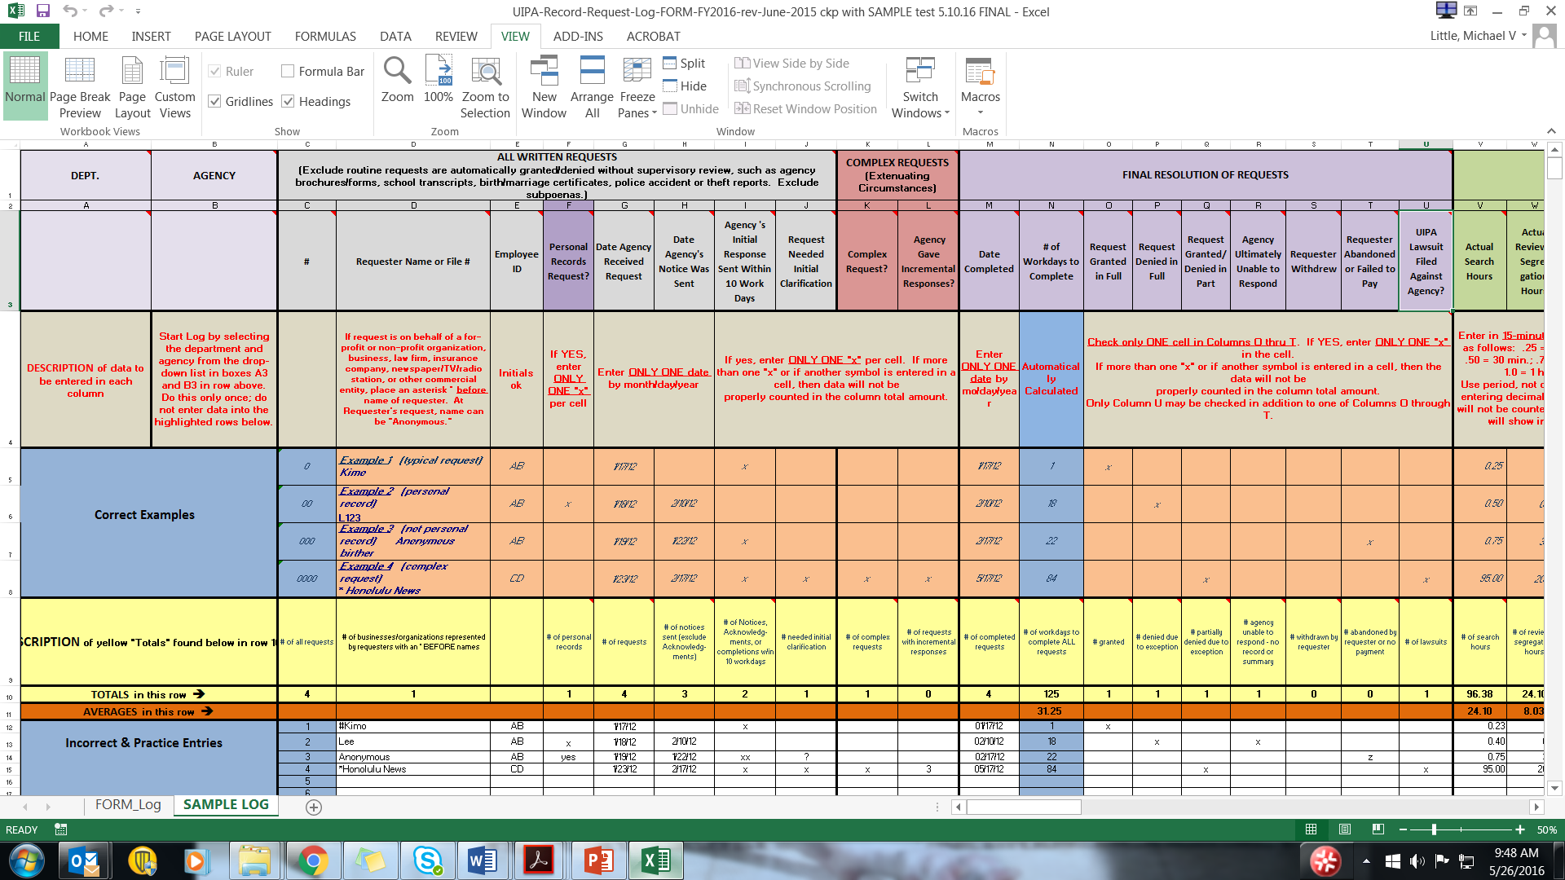

Notes:
The Log itself is an Excel spreadsheet found on OIP’s website at oip.hawaii.gov. You can find two worksheet tabs on the bottom left. One worksheet is the Log form itself, which the agency will be using on a computer to enter data. When you view it on the computer, you won’t see the Examples shown on this slide and you will see that it is very long because it contains many columns of automatic calculations and statistics that OIP needs. You do not have to enter any data in most of those columns, but please do not eliminate any of them from the Logs that will be submitted by the agency to OIP.
OIP has created a second, shorter worksheet as a Sample Log, as shown in this slide, which does not have all of the columns, shows various Examples, and can be used for practice and training. You will find a pre-formatted PDF version of the Sample Log on OIP’s Training page, which you should print out, preferably in color, to use during this training.

Slide 9
Notes:
Throughout this training, we will be referencing the row numbers on the far left, which should not be confused with the request number entered for the white entries of the Log in Column C. Column letters can be found in row 2 at the top of the spreadsheet.
Column headings are found in row 3, and descriptions of the data to be entered in the columns are found in row 4. The yellow descriptions in row 9 refer to the “Totals” that the Log automatically calculates in row 10. Row 11 is highlighted in dark orange because it calculates “Averages.”
The four orange highlighted Examples on the Sample Log show you how to properly enter data in rows 5 through 8. The white rows 12 through 15 of the Sample Log show data that has been erroneously entered. By the end of this training, you should be able to identify the cells in the white data entry rows that contain mistakes and know why they are mistakes.

Slide 10

Log’s colored areas are to help, not for data entry. Enter data only in white cells, and not all white cells
The Log has pop-up instructions … just mouse cursor over the column heading.
Notes:
Don’t be intimidated by the length of the Log. Remember how colorful the Log is – all of those colored areas are not for you to enter data, and instead they help provide you instructions or automatic calculations. More than half of the Log’s columns are automatically populated for you.
All you have to do is follow the instructions to properly enter the raw data in the white cells only. And not all white cells have to be filled in – for example, in the request resolution section, out of 9 columns, you may only have to input data into two cells. For a simple typical request, you may only have to input 11 data entries for the entire Log.
There are many aids, right there on the Log, to help you with the data entry process. In addition to the instructions that you can see in the Log’s headings and descriptions, there are also more detailed pop-up instructions, which help provide reminders of the UIPA’s requirements. Just move the cursor over a column heading to get instructions to pop up.

Slide 11
For detailed UIPA Log Instructions, Frequently Asked Questions, & other training materials:
visit OIP’s Training page at oip.hawaii.gov
click on Laws/Rules/Opinions, then the UIPA page: http://oip.hawaii.gov/laws-rules-opinions/uipa/uipa-record-request-log/
Notes:
Full written instructions for using the UIPA Log, along with Frequently Asked Questions, a Tip Sheet, and a Log Process Chart are also available on OIP’s website at oip.hawaii.gov, on the UIPA page. OIP understands that people study and retain information in different ways, so it has provided a variety of training materials to help you understand the Log process.

Slide 12
Hawaii’s Public Records Law
HRS § 92F-18 requires each agency to:
Inform employees of the UIPA’s requirements
Compile a report using forms prescribed by OIP
Ensure that the information remains accurate and complete
Notes:
Why do agencies need to use the Log? Because the UIPA (HRS § 92F-18) requires agencies to:
take steps to assure that its employees are informed of the UIPA’s requirements;
compile a public report using forms prescribed by OIP;
and annually report to OIP to ensure the information remains accurate and complete.

Slide 13

Benefits! … the UIPA Log helps an agency to:
Track written UIPA requests for records & the agency’s response
Report requests & outcomes
Assist the public & comply with UIPA
Calculate fees & costs
Keep government open and accountable
Notes:
The Log provides a uniform method for state and county agencies to stay on TRACK and comply with the UIPA.
1) The Log is a tool to help agencies keep TRACK of written requests for public and personal records, and when and how the agency responded.
2) The Log provides a uniform method to REPORT to OIP the numbers and types of record requests and their outcomes.
3) The Log helps agencies to properly ASSIST requesters and comply with the UIPA.
4) The Log helps agencies to CALCULATE fees and costs.
5) The Log advances the UIPA’s goal to KEEP GOVERNMENT OPEN and agencies accountable to the public.

Slide 14
Make copy (not PDF) of Log and submit with Checklist to OIP through department’s UIPA Coordinator: January 31: “Semiannual Log” due for requests received from July 1 through December 31 July 31: “Year-end Log” due for requests received from July 1 through June 30
Start a new agency Log each July 1, but keep the Log for the prior FY open during July to record how requests received thru June 30 were resolved
Notes:
An electronic copy, not PDF, of the agency’s Log along with the Checklist must be submitted to OIP twice a year by the department’s UIPA Coordinator. For the semiannual report due on January 31, the agency should save its Log entries from July 1 through December 31 as its “Semiannual Log,” which is the copy that it must submit to OIP. The agency can continue to use its original Log for the entire fiscal year from July 1 through June 30, and turn in a copy to OIP as its “Year-end Log” on July 31.
The agency should start a new Log each July 1 for requests received when the new fiscal year begins. Because all requests will not be completed in the same fiscal year they were made and in order to record how requests received through June 30 were resolved, agencies should keep open the Log for the prior fiscal year until approximately July 15. Therefore, for a brief time, agencies will be using two Logs when one fiscal year ends and the other begins.

Slide 15
Checklist
Checklist helps you spot data errors
Before submitting Checklist to OIP, please correct any data entry errors.
Use correct Checklist: FY 16 different from FY 17
Submit completed Log and Checklist to OIP by January 31 and July 31 each year.
OIP will upload your Log totals and routine requests estimate to the Master Log on data.hawaii.gov and will prepare reports posted at oip.hawaii.gov.
Notes:
The Checklist helps to ensure that the Log data has been properly entered by the agency before the Logs are submitted to OIP, and they provide hints on how to spot and correct data entry errors. Like the Log form, the Checklist form is found on the UIPA Log training page of OIP’s website. Please be sure to use the correct Checklist form. The FY 2016 Checklist will be removed from OIP’s website after July 31, 2016, as all FY 2016 Logs and Checklists should have been submitted to OIP by then. Separate training on the Checklist is available on OIP’s Training page at oip.hawaii.gov.
The Checklist must accompany the agency’s completed Log and submitted to OIP, through your UIPA Coordinator, on January 31 and July 31 each year.
OIP will post the routine requests estimates, along with the rest of the agency’s Log summaries, onto the Master Log at data.hawaii.gov. OIP will also prepare reports and its own graphs and charts summarizing the Log data, which will be posted on the Reports page at oip.hawaii.gov.

Slide 16


The UIPA Log has 4 main parts:
Identification
Resolution of requests
Fees & costs
Time to respond
Notes:
Let’s learn how to use the Log by first breaking down this Excel spreadsheet into its four main parts.
The first part basically identifies the department, agency, record requester, agency employee working on the response, and type of record request.
The second part records how and when the requests were resolved.
The third part calculates fees & costs based on the agency’s input of hours, costs, and fee waivers.
The fourth part calculates the time to respond to record requests.
Note that agencies do not have to enter any data in the fourth part, as the Log automatically calculates everything here, based on data entered by the agency in the earlier sections.

Slide 17
Notes:
What is found in all parts of the Log is the yellow highlighted Row 10 for “Totals,” which is just under the larger yellow row of “Descriptions” of the Row 10 “Totals.” The Row 10 “Totals” are calculated from the agency’s entries in the white rows below, and do not include the hypothetical numbers from the “Examples” above it in rows 5 to 8. The “Totals” are posted at the top of the Log in Row 10 like this, so that the agency can enter data in the rows below for as many record requests that it may receive, while always being able to view their totals. If the agency receives more than 1,000 record requests in a year, it can add new rows at the bottom or call OIP for help.
The yellow highlighted row of “Totals” will be partially redacted and it is the only portion of the agency’s Log that will be uploaded onto the Master Log at data.hawaii.gov, where OIP or any member of the public can then create their own summaries and visualizations to see how each agency, each department, each County, and the State as a whole are doing in fulfilling UIPA record requests.

Slide 18
Notes:
The larger yellow Row 9 describes what is being calculated by the “Totals” in Row 10 and dark orange “Averages” in Row 11. Some of the yellow cells have additional pop-up explanations.
Let’s see how some of the “Descriptions” work. In Row 9, we see from the description that yellow cell C10 shows the number of requests received. Yellow cell D10 shows the number of requesters that were identified with an asterisk * as representing a business or non-profit organization.
While Column G shows the dates when requests were received by agencies, the yellow cell G9 explains that the “Total” in yellow cell G10 is for “# of requests” and equates to the total number of record requests received by the agency.
In Column L, the yellow cell L9 explains that the Total below it (yellow cell L10) is for the total “# of requests with incremental responses,” which is not the total number of incremental responses sent by the agency.
In Column N, the “Total” in yellow highlighted cell N10 calculates the total number of days to complete all requests.

Slide 19
Add slide showing the Log with the orange row of Averages.
Notes:
Yellow cell N10 shows the total number of workdays to complete all requests by the agency. Below it, the agency’s average number of workdays to complete a request is shown in dark orange cell N11.
Later in the Log, you will see that other averages have been calculated for the agency in dark orange row 11. The agency’s averages can be compared to the department’s, County’s or the State’s averages that will be calculated from data entered onto the Master Log at data.hawaii.gov and reported in OIP’s State and County reports of the Log results.

Slide 20
The UIPA Log-- First part is:
1. Identification
Notes:
Now, let’s explain the first part of the Log, which identifies who and what we’re dealing with, and who is responsible for resolving the request.

Slide 21
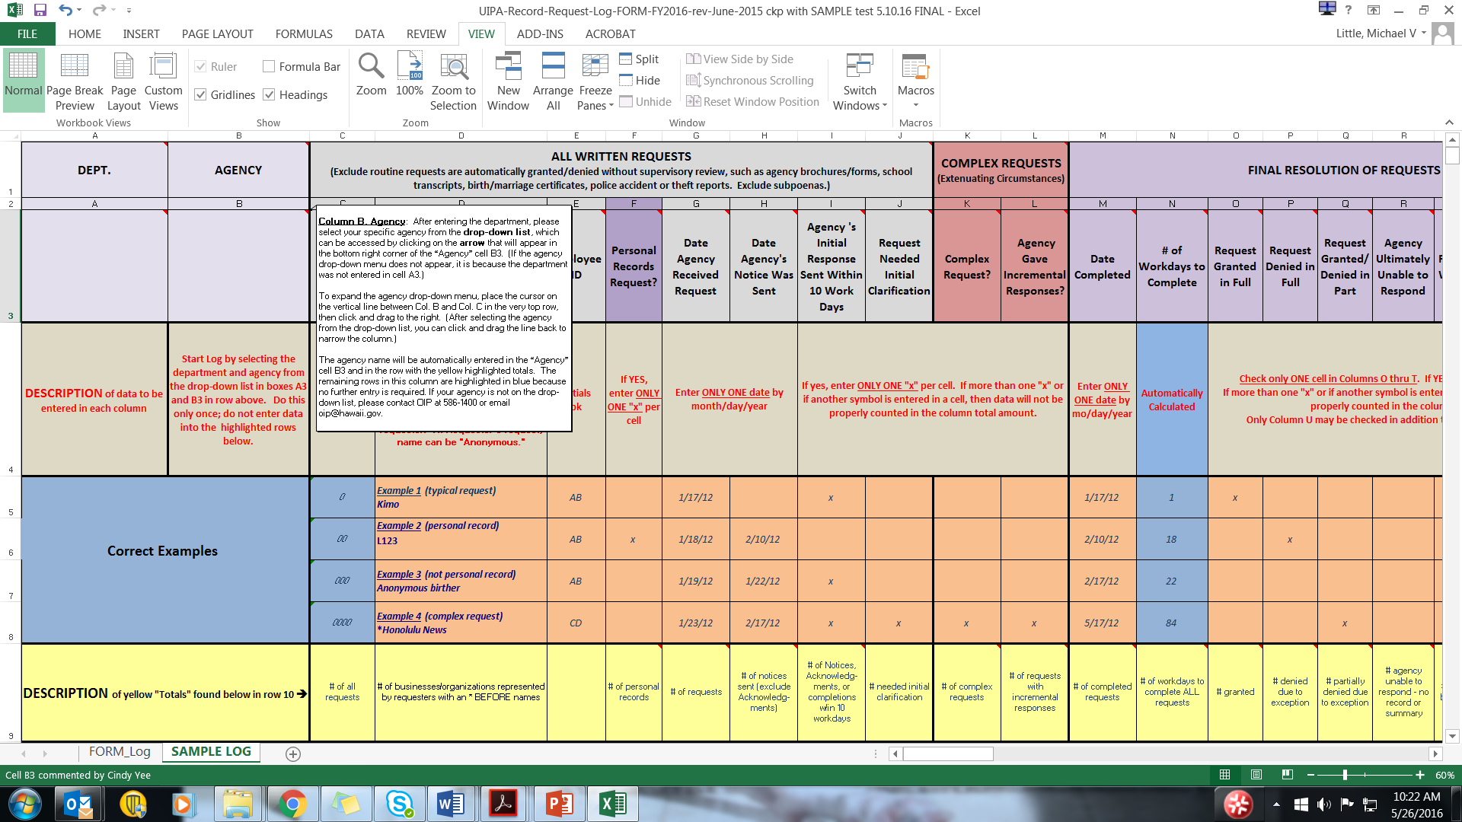
Notes:
The first time your agency uses a Log, the department and agency names must be entered. Instructions on how to enter the department and agency names will pop-up when you click on the small red triangle on the upper right corner of cells A3 and B3.

Slide 22
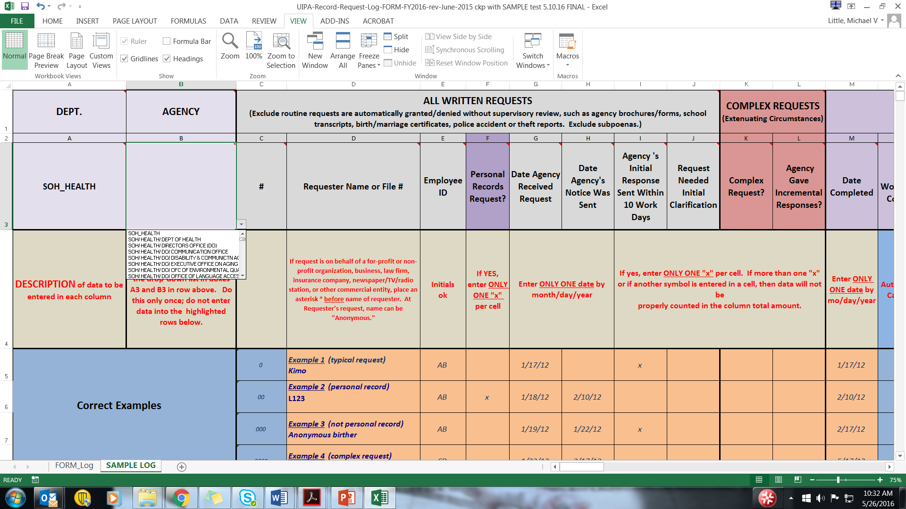

Notes:
Please use the drop down lists that will appear when you click on the arrows that will become visible when you place the cursor the bottom right corner of cells A3 and B3. Here, you see how the department name has been selected from the drop-down list and added into cell A3. Do the same in the “Agency” box by selecting your agency from the drop-down menu that will appear when you move your cursor over the bottom right corner of cell B3. Note that the “Agency” drop-down list will not appear unless a department is first entered in cell A3.
After the first person has properly entered your department and agency into the Log heading, you don’t have to do this again.

Slide 23
Notes:
Now, let’s go to the middle of the screen, to see what you have to do each time you enter data for a request. You must start by identifying the requester’s name or file number or initials in Column D, and the initials of the employee who will be responding to the request in Column E.
No data entry is required for Column C, which automatically numbers the requests and is not the row number for the Excel spreadsheet. Note that when a row is inserted or deleted, the Column C numbers are not renumbered.

Slide 24
Columns C & E can be altered
Columns F on
must not be altered
.
Notes:
Columns C and E will be deleted by OIP before Log data is uploaded onto data.hawaii.gov, so agencies may alter these columns to suit their needs.
Column F on must not be altered because changes may adversely affect the Log’s formulas or drop-down menus and the data that is eventually uploaded onto data.hawaii.gov may not align with the Master Log.

Slide 25
Column D: Requesters’ names
Place asterisk * before name to ID business or nonprofit organization
Col. D will be deleted for posting on Master Log, but not deleted by OIP if Log itself is requested
Notes:
Column D asks for the Requesters’ names, so the agency should enter the full names, initials, file numbers, or if applicable, “Anonymous,” in this column so that it can identify the request later, if necessary.
An asterisk * should also be placed at the start of Column D to identify requesters who represent a for-profit or non-profit organizations, including a business, law firm, insurance company, newspaper/TV/radio station, or other commercial entity or advocacy group. This information is optional, and not required by law, but will provide data on whether individuals versus organizations are making and paying for the more expensive or complex record requests.
Column D will be deleted by OIP before it is uploaded onto data.hawaii.gov, but not if a record request is made for the Log itself. Although an agency may use this column for notes or additional information, it should be aware that the agency or OIP may receive record requests for the Log itself. Although the Requesters’ names on the Log should not be redacted for most government record requests, the names may have to be redacted for personal record requests if an exception to disclosure applies. To avoid having to go back through a Log to make redactions at a later date, OIP recommends that the agency enter only the Requester’s initials or case number for personal record requests.
Although the personal record requester may be identified in Column D as “Anonymous” and referred to by file number, please keep in mind that a personal records request cannot be made anonymously as it is necessary for the agency to verify the requester’s right to access the personal records being sought. A government records request, on the other hand, can be made anonymously.

Slide 26
Column D: Redacting Requesters’ names
Requester’s names not redacted for government record requests made under Part II of the UIPA
Use Requesters’ initials or case number for personal record requests made under Part III
“Anonymous” ok on Log, but personal record requests cannot be made anonymously
Part II government records requests may be made anonymously
Notes:
Please keep in mind that while the Requesters’ names should not be redacted for most government record requests made under Part II of the UIPA, the names may have to be redacted for personal record requests if an exception to disclosure applies under Part III. To avoid having to go back through a Log to make redactions at a later date, OIP recommends that the agency enter only the Requester’s initials or case number for personal record requests.
Although the personal record requester may be identified in Column D as “Anonymous” and referred to by file number, please keep in mind that a personal records request cannot be made anonymously as it is necessary for the agency to verify the requester’s right to access the personal records being sought. A Part II government records request, on the other hand, can be made anonymously.

Slide 27
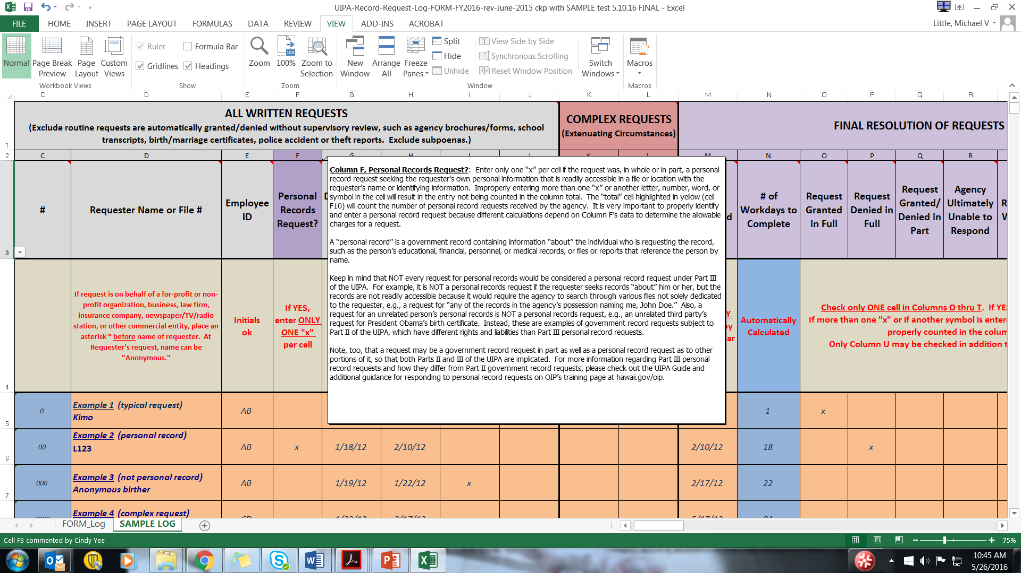
Notes:
It is really important for you to understand the difference between a government record and a personal record, because different rules and charges apply, and the Log will do different calculations depending on how you identify the request. Additionally, agencies should be aware that they have different duties and potential liability with personal record requests, which could result in the court’s imposition of actual damages of no less than $1,000 for a knowing or intentional violation by the agency.
If you need a refresher as to “What is a personal records request?,” the answer will pop up in Column F. Let’s take a closer look at personal records.

Slide 28

Column F:
Q. What is a “personal record?”
A “personal record” is a government record that contains information “about” the individual who is requesting the record.
But records that are not readily accessible need not be disclosed.
Notes:
The T-shirt on this slide is not the official legal answer, but it’s one way to remember what a personal record is. As the T-shirt says, “It’s All About Me.”
A “personal record” is a government record that contains information “about” the individual who is requesting the record. The record may be the individual’s educational, financial, or medical records, or items that reference the individual by name or otherwise. The information can be in a file specifically labeled with the requester’s name, or it could be in another file.
But if the agency cannot readily find or identify other files containing the requester’s personal records, then those records are not “accessible” and need not be disclosed. (HRS 92F-21) In other words, the agency need not expend an unreasonable amount of time or effort to search through all of its files to try to find information about the requester.

Slide 29
Not every request for personal records would be considered a personal record request under UIPA, Part III
For example, if a requester seeks information “about him” that is not readily accessible because the agency would have to search through all of its files for such information, then it is not a personal records request.
As another example, a request for an unrelated person’s personal records, such as a birth certificate, is not a personal record request. President Obama can make a personal records request for his own birth certificate. But, if an unrelated third party makes a request for President Obama’s birth certificate, it would be a government record request subject to Part II of the UIPA, which has different requirements from personal record requests.
Notes:
Not every request for what may normally seem to be personal records would be considered a personal record request under Part III of the UIPA.
For example, as noted previously, if a requester seeks information “about” him that is not readily accessible because the agency would have to search through all of its files for such information, then it is not a personal records request.
As another example, a request for an unrelated person’s personal records, such as a birth certificate, is not a personal records request. President Obama can make a personal records request for his own birth certificate. But, if an unrelated third party makes a request for President Obama’s birth certificate, it would be a government record request subject to Part II of the UIPA, which has different requirements from personal record requests under Part III of the UIPA.

Slide 30
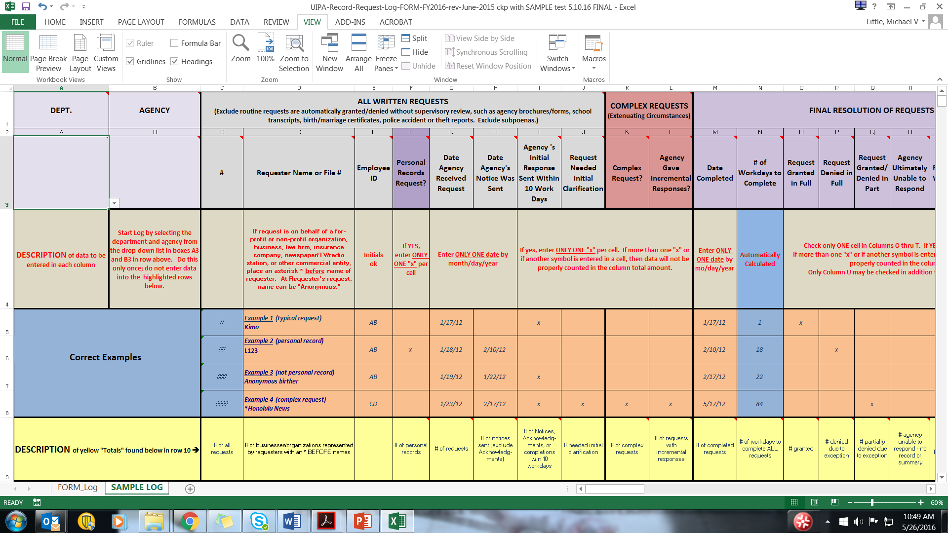
Notes:
Let’s learn how to enter personal records requests by looking at Examples 2 and 3 on the Sample Log. Example 2 concerns a personal records request for information about requester whose name should be entered by initials or a file number to avoid having to redact it later. Here, we have entered the file number “L123” in Column D and only one “x,” under “Personal Records Request?” in Column F. Note that the sums won’t tally correctly and the formulas will not work properly if you enter more than one “x” or a different symbol.
Also, when you properly enter a single “x” in Column F to identify a personal record, then you’ll see later that the Log will automatically highlight in purple the corresponding cells in Columns AB and AC to remind you that fee waivers should not be entered since no search, review, and segregation fees can be charged in the first place for personal records.

Slide 31
Notes:
Let’s turn now to Example 3 by the Anonymous Birther seeking President Obama’s birth certificate. This is not a personal records request. Why? A request for an unrelated person’s personal record, such as a birth certificate, is not a personal record request for your own record. Therefore, no “x” has been entered in Column F for the Anonymous Birther’s request.
Although the Log may identify the requester as being “Anonymous,” remember that a personal records request cannot be made anonymously because you have to know that the person is entitled to access the information being sought that is “about’ himself or herself.

Slide 32
Notes:
Next, let’s look at how we entered the Requester’s name in Example 4. Because we know that it was a request by a business, we entered an asterisk * before the Honolulu News. Be sure to use an asterisk and not another symbol so that the Log will count it in its total of record requests submitted on behalf of businesses or nonprofit organizations, including law firms, media companies, insurance companies, advocacy groups, and other entities.
And because this request was a complex request, we will mark a single “X” in Column K. We’ll talk more about complex requests in a little while.

Slide 33

Columns G thru J:
Date of agency’s receipt of request
Date agency sent its Notice to Requester
Did agency initially respond within 10 work days?
Did request need initial clarification?
Notes:
For now, let’s move on to Columns G through J, which ask you to enter the date that the agency received the request and the date the agency sent its “Notice to Requester,” whether the agency initially responded within ten work days, and whether the request needed an initial clarification.

Slide 34


Notes:
Column G asks for the date that the agency received the request. Note that the yellow highlighted “total” in cell G10 will count each entry as a request and will provide the total number of record requests received by the agency. As the instructions in row 4 remind you, enter only one date per request in order for it to be properly added in the “Totals” cell G10. Remember, too, that the numbers in the yellow “Totals” row are based on the data entries in the white rows below, which are not shown on this slide. The “Totals” are only being shown here to explain how they were calculated and are not based on the entries in the highlighted Examples that are exhibited.

Slide 35
Notes:
Column H asks for the date that the agency sent its “Notice to Requester.” The UIPA requires the Notice to be sent within 10 work days after receiving a request. In complex cases involving extenuating circumstances or voluminous records, the agency can instead send an Acknowledgment within 10 work days, but it must still send out the Notice to Requester within 20 work days after receiving the request. In complex cases, therefore, please enter the date that the Notice, not the Acknowledgment, was sent. Only one date must be entered, so that the yellow “Totals” cell H10 will add it to the total number of Notices sent by the agency.

Slide 36
Notes:
Column I is not automatically calculated for you. Please manually add one “x” when the agency initially responded within 10 workdays after receiving the request. The initial response is defined as a Notice, Acknowledgement, or even the completion of the case by sending all requested records. If the agency initially responded or completed the case within 10 workdays after receiving the request, then one “x” should be entered in Column I to indicate that the agency sent its initial response in a timely manner. Do not count the day the request was received, but do count the day that the response was sent.
Sometimes, the agency cannot check Column I because it is unable to respond to a request that is unclear and it will need to have the request clarified by the requester. If so, then the agency should enter one “x” in Column J to show that the request needed initial clarification. This data will help to explain why an agency may not have been able to send out its initial response within 10 days.

Slide 37

Notes:
Note that Column I can be checked even if Column H shows that the date of the Notice in a complex case was more than 10 days after receipt of the request, so long as the agency sent its Acknowledgement to the requester within the first 10 days. Even if the agency does not complete the request, it should at least send out a Notice or Acknowledgement within the first ten days and should be able to enter in “x” in Column I.

Slide 38
Notes:
When you are calculating the days for Column I, do not be concerned if they do not match with the automatic calculations in Column N. Unlike the manual calculations by the agency to complete Column I, Column N’s automatic calculations may overstate the number of workdays to complete a request because it includes the day that the request was received. It was necessary to do this because otherwise, a request completed the same day it was received would have been counted as zero days. Also, Column N does not exclude state holidays.

Slide 39
Column K Complex Requests
Enter only one “x” in Column K if this is a COMPLEX request involving extenuating circumstances or voluminous records
If more than one “x” or any other letter, word, or symbol is improperly entered, Log will count it as a typical request, not complex
Notes:
Now, let’s move on to see what is needed to identify a COMPLEX record request involving voluminous records or extenuating circumstances, which will often take more time and/or entail higher fees and costs. For further assistance in how to handle complex record requests, the pop-up instructions will refer you to the “OIP’s Informal Guide to Processing Large or Complex Record Requests,” which can be found through the training link on OIP’s home page at oip.hawaii.gov.
It is very important to properly enter the data in this section, so that we can distinguish between the typical requests and complex requests, and apply the correct formulas in the Log. To identify a complex request, only ONE “x” should be entered in Column K.
The yellow highlighted totals in cell K10 will count any box in Column K with only ONE “x” in it as a complex request. If more than one “x” or if another letter, word, symbol, or date is entered in Column K, then the Log will again presume that it is a typical record request and the formulas for complex requests will not work with this entry. Therefore, be sure to enter only ONE “x” in Column K to properly identify a COMPLEX case.

Slide 40
Column L: Complex Requests – Incremental Responses
Enter only one “x” in Column L if incremental responses were sent in a complex case
Notes:
Only one “x” should also be entered in Column L, if the request is complex and the agency needs to provide its response in different segments over time. Column L shows that incremental responses were provided. The dates or numbers of incremental responses should not be entered – Column L should have only ONE “x” if any. When the last incremental response is provided and the complex request is completed, then you will enter the completion date in the next column, M.
ENTRY TIP: Columns K and L apply to COMPLEX requests only. For the typical request that can be completed within a short period of time, there will be no entries in these columns.

Slide 41
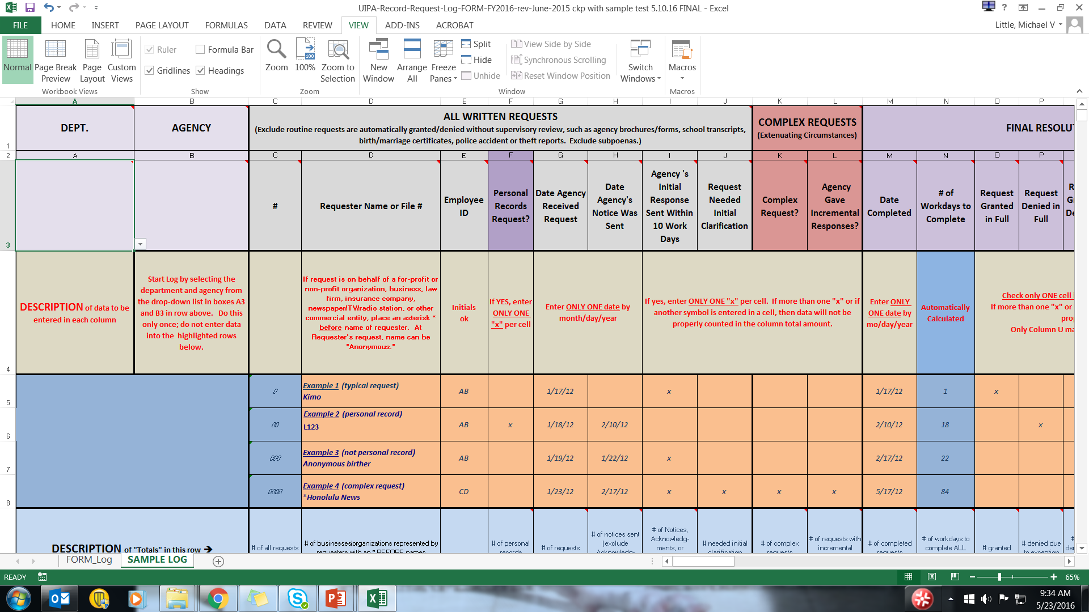

Notes:
Let’s put all this together and see how to enter the data in the Log.
In Example 1, the agency received the request on January 17 per Column G. Although it did not send a notice to requester, as shown by the blank in the next column to the right, Column H, the agency provided all requested records the same day, January 17, per Column M’s completion date. To the right of Column M, the blue highlighted Column N automatically calculated the number of work days to completion as being 1 day. Consequently, the agency placed an “x” in Column I for “Agency’s Response Sent Within 10 Days.”
In Example 2, in Column G, we see that the agency received the request on January 18th. Column H shows that the agency sent a Notice to the requester on February 10. And in Column M, the date completed is also February 10, which Column N calculated was 18 work days. So at a glance, we have the key dates for this request and know that the agency did not timely send its notice, so no “x” is marked in Column I.
Example 3 shows that the request was received on January 19 (Col. G) and the Notice went out within two days, not counting the date of receipt, on January 22 (Column H), so the agency checked Column I as having timely responded. It appears that the request was abandoned by the requester or the requester failed to pay, so it was closed as being completed on February 17 per Column M, and thus took 22 days to complete per Column N.
In Example 4, a complex record request from the Honolulu News, we see in Column G that the agency received the request on January 23, and sent its Notice to Requester on February 17 as shown in Column H. While the Notice was sent more than 10 days after the request was made, the agency could still place one “x” in Column I because it sent an Acknowledgement within the first ten days. At the same time that it sent its Acknowledgement, the agency asked for initial clarification of the request, which is why it also placed one “x” in Column J. Because the agency needed additional time to search for, review, and segregate the voluminous records being sought by Honolulu News, it considered this to be a complex request as shown by the one “x” in Column K. The agency also had to provide its responses in different segments over time, so it placed one “x” in Column L for incremental responses. The last of the agency’s incremental responses was sent on May 17, 2012, which is the completion date entered by month/day/year in Column M. The Log automatically calculated that it took 84 work days for the agency to complete the complex request, per Column N.
ENTRY TIP: Notice that Row 4 highlighted above the examples will give you hints on how to enter the data. It tells you that for Columns G. H, and M, you should enter the date by “mo/day/year” and that only ONE date should be entered. Row 4 also reminds you to enter only ONE “x” per box in Columns I through L. And cell N4 has been highlighted in blue to let you know that the number of workdays to complete requests will be automatically calculated for you.

Slide 42
The UIPA Log-- Second part is:
1. Identification
2. Resolution of requests
Notes:
Having identified the request in Part 1, let’s go on to Part 2 and look at the section that records how requests are ultimately resolved.

Slide 43

Columns M & N: Request Resolution
Col. M = Date completed
Col. N = # of workdays to complete is automatically calculated, based on date the request was received and date of completion. (Holidays are included as a “workday.”)
Notes:
The request resolution section starts by asking for the date of completion (Column M), which is when the agency has provided or made the requested records available or provided its final response to the requester. There should be only one completion date; if the request has not been completed, then this cell should be left blank until it is done. If the agency sent a Notice explaining that it was denying the request in whole or was unable to respond to the request because the records were not maintained or a requested summary was not readily retrievable, then the Notice date is the completion date. If the agency sent a Notice stating that the request would be denied in part or granted in full, then the date the records were mailed, emailed, or available for the requester to pick up at the agency is the completion date, regardless of whether payment was ultimately made or when the copies were actually made or whether records waiting for pickup were actually picked up.
For example, if the Notice required prepayment of estimated fees and costs, and the agency mailed or e-mailed the records to the requester after receiving that prepayment, the completion date would be the date the records were mailed or e-mailed. If the agency informed the requester that the records would be available for pickup or review as of a certain date, then that date would be the completion date. If the Notice indicated that the records would be provided in increments, then the date that the final increment is mailed, e-mailed, or made available becomes the completion date.
If the agency simply provides all the requested records instead of sending a Notice, then the date the records were mailed, e-mailed, or otherwise provided to the requester is the completion date. If the requester voluntarily withdraws the request, then the withdrawal date is the completion date. If the agency sent a notice seeking initial clarification of the request or payment of fees and the requester does not respond within 20 business days, then the request may be presumed to be abandoned and completed on the day that the agency’s notice was sent. All of these examples are found in the written Instructions that you can download from OIP’s website.
Based on the dates when the request was received and completed, the Log will then automatically calculate the number of workdays, excluding weekends, that it took the agency to complete each response (Column N). Column N gives a good estimate of the number of workdays that it takes to complete requests, but is not totally accurate as holidays are counted. If a request is received and completed on the same day, Column N will count it as one workday to complete. Do not be too concerned that Column N’s calculations are not exact. OIP is aware of its limitation and can check Column N’s estimate against Column I’s data that agencies enter when they meet the UIPA’s 10-day requirement to send out their initial responses to record requesters.
Entry Tip: Note that Column N has been highlighted in blue. The highlight indicates that an amount will be automatically calculated by the Log and that NO DATA ENTRY by the agency is required.

Slide 44
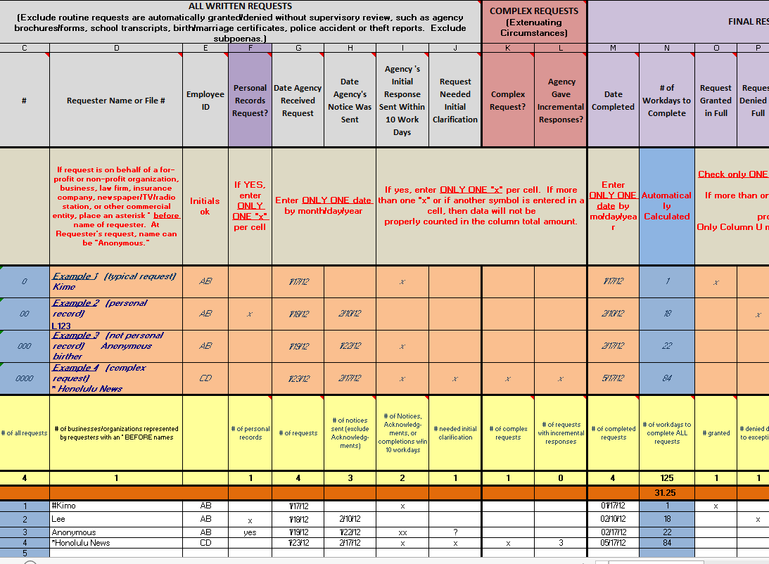
Notes:
Let’s look at Column N for the number of workdays that it took to complete each request. If you look at the data entered in the white cells on the bottom of this slide, you will see in Column N highlighted in blue, the numbers 1, 18, 22, and 84, which total 125 days as calculated in yellow highlighted cell N10. Cell N10 is the total number of workdays for the agency to complete all record requests entered in this Log.
The average number of days that the agency takes to complete record requests is also automatically calculated in the orange cell N11, which is 31.25 days in this Sample Log. Note that given this small sample, the 84 days taken to complete the complex request skewed the result and gave an abnormally high average for completion days.
Entry tip: The Log helps the agency to keep track of requests so that they don’t fall between the cracks, in case a staff person is sick, goes on vacation, or leaves the agency. The agency will be able to easily see in Column M where there are blank spaces, which means that those requests were not completed and require follow-up. The agency can also tell how timely its responses are by looking at the average number of days for completion in cell N11, and will eventually be able to compare its average to other department, other counties, or the state as a wholes.

Slide 45
Columns O thru U: Request Resolution
Request granted in full?
Request withdrawn?
Denied in full?
Granted/Denied in part?
Agency unable to respond?
Requester abandoned or failed to pay fees & costs?
Lawsuit filed?
An agency should check ONLY ONE CELL in Columns O through T, but can additionally check Column U. See Example 4.
Notes:
Columns O through U must be filled out by the agency to report how a UIPA record request was ultimately resolved. Each of these columns has pop-up instructions to guide the agency. The agency may check off ONLY ONE CELL in Columns O through T to indicate how the request was finally resolved.
It is easy to determine that a request was granted in full or that a requester voluntarily withdrew a request. A request may be denied in full or in part when the agency claims an exception to disclosure. But why would an agency be unable to respond to the request and when does a requester abandon a request?
The agency may be ultimately unable to respond per Column R because the agency either (1) does not maintain the record or (2) the request requires the creation of a summary or compilation of information that is not readily retrievable. (See Example 4, Honolulu News.) If an agency is not providing records because it is unable to respond to a request, then do NOT also check Column P or Q showing that the request was denied in whole or in part – remember, only one cell in Columns O through T should be checked. Also, please do not check this Column R to indicate that the agency could not initially respond to the request if the agency was then able to obtain clarification from the requester – check only Column J if the agency was not initially able to respond to the request.
A request may be deemed abandoned in Column T if the agency initially asked for further clarification or for payment of fees, and the requester failed to provide the clarification or payment within 20 business days, or if the agency has given notice and made the records available to the requester who wanted to pick them up but fails to do so. If a file is abandoned, then the date that the agency sent the notice for payment or made the records available becomes the completion date for Column M. (See Example 3, Anonymous Birther.)
Note that if a requester fails to pay fees from previous record requests, including abandoned requests, OIP’s rules allow the agency to require prepayment of all outstanding fees that the requester had agreed to pay for services previously rendered by the agency, before the agency must release any records in a subsequent request (by the same requester).
Finally, if the agency learns that the requester is filing a lawsuit to obtain access to the records, then it should place one “x” in Column U. Note that Column U for lawsuits is the only one that may be checked in addition to ONE of the previous columns, O through T.

Slide 46
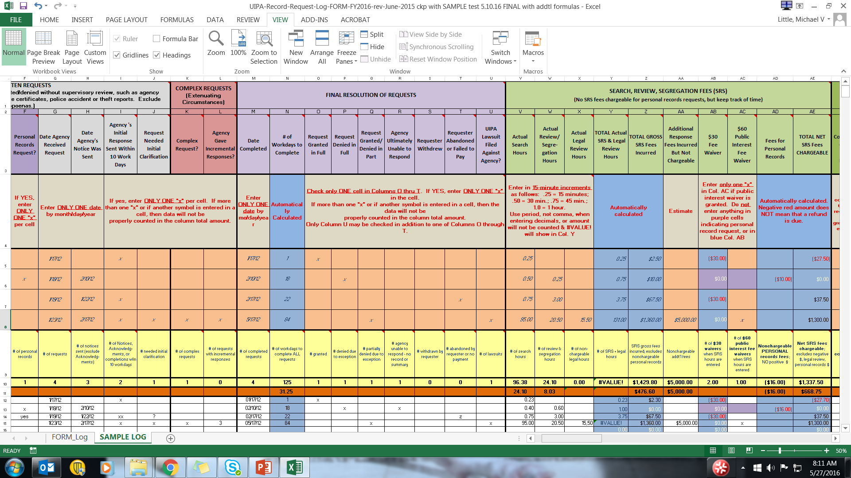

Notes:
Here’s the entire “Request Resolution” section for examples shown in the Sample Log. Let’s look at the last example highlighted in orange for the “Honolulu News,” which was completed on 5/17/12 when the last incremental set of records was provided to the requester. The Log has automatically calculated in Column N that it took 84 workdays (including holidays) to complete the request.
In Column Q, the agency has entered one “x” for “Request Granted/Denied in Part,” because it had to hold back some of the records that it claimed were protected by a confidentiality statute.
Although only one of Columns O through T could be checked, the agency properly entered an “x” in Column U for “UIPA lawsuit filed against agency” because the requester filed a lawsuit challenging the agency’s partial denial. Please note that the agency may not know at the time it submits its Log to OIP whether a lawsuit has been filed against it. The agency should do its best to fill out the Log and should separately report the lawsuit information to OIP when it becomes aware of the lawsuit.
Again, please notice all the single “x’s” in the boxes in the Request Resolution section. Please enter only one “x” per box so that the data will be properly counted in the column’s total amount. If more than one “x” is entered or if another character is entered, the data will not be properly counted and totaled in the yellow highlighted row. Remember, in this slide, the yellow “Totals” do not add up what you see in the Examples above because the “Totals” are based on data entries in the white rows below that are not shown on this slide.

