Slide 1


The UIPA Log-- Third part is:
1. Identification
Resolution of requests
Fees & costs
Notes:
Having identified the request and tracked its resolution, let’s now go on to the third part of the Log, which automatically calculates fees & costs based on the agency’s input of search, review, and segregation hours, copying and delivery costs, and fee waivers.

Slide 2
UIPA Log, Part 3: Fees & Costs
Automatic Calculations based on agency’s input of hours, costs, & fee waivers
Search, review, segregation fees (SRS) -- Fee waivers
Copy/delivery costs
Total fees and costs – ALL compared to COMPLEX requests
Notes:
The Fees and Costs section breaks out the agency’s expenses by (1) search, review, segregation fees, and (2) copy and delivery costs. Then, based on the agency’s input, the Log calculates for the agency the total fees and costs for ALL requests as compared to COMPLEX requests by: (1) what requesters actually paid, (2) what the agency is allowed to charge, (3) what the agency actually incurred, and (4) what the agency incurred but could not recover.
The Log also calculates the number and types of fee waivers granted and the copying and delivery costs actually incurred by agencies to fulfill record requests.
Ultimately, this data helps to evaluate the costs and benefits of the UIPA as well as whether amendments to OIP’s administrative rules, adopted in 1998, should be made.

Slide 3

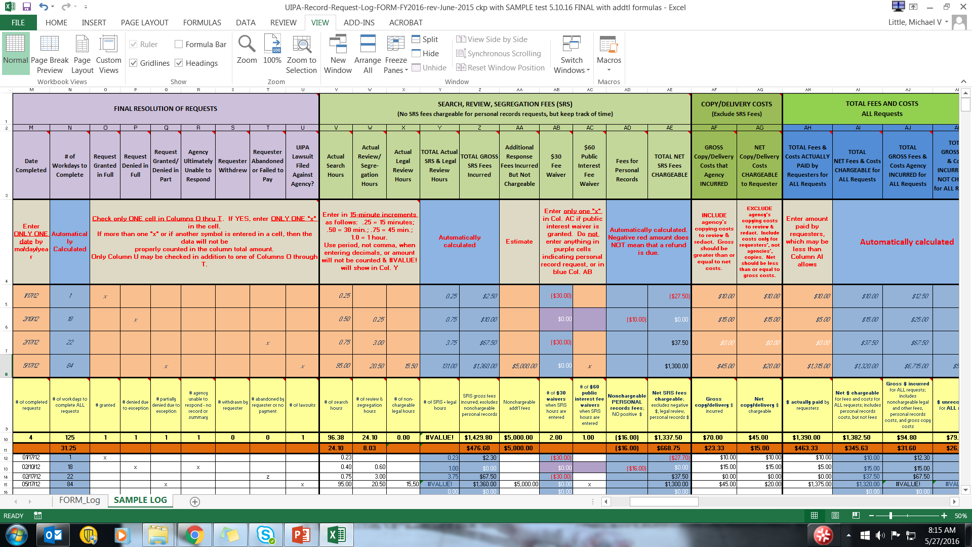
Notes:
This slide shows that we are in the section of the Log for Search, Review, Segregation (“SRS”) fees.
Let’s start by explaining what these fees are.

Slide 4

Search, Review, Segregation Fees (SRS) Q & A
What are SRS fees? These are fees that the agency may charge for time spent searching for, reviewing, and segregating government records in response to a request: $2.50 per fifteen minutes or fraction thereof for searching for the record; and $5.00 per fifteen minutes or fraction thereof for reviewing and segregating the record.
Notes:
The UIPA (HRS Sec. 92F-42(13)) required OIP to adopt rules setting forth fees and other charges that may be imposed to search for, review, and segregate or redact government records in response to a request. OIP’s administrative rules (H.A.R. Sec. 2-71-31), adopted in 1998, set forth the allowable fees as follows:
To search for the record, the agency may charge $2.50 per 15 minutes or fraction thereof.
To review and segregate the record, the agency may charge $5.00 per 15 minutes or fraction thereof.
Let’s see how to properly enter SRS times and copying costs, and let the Log calculate the fees and costs for us.

Slide 5
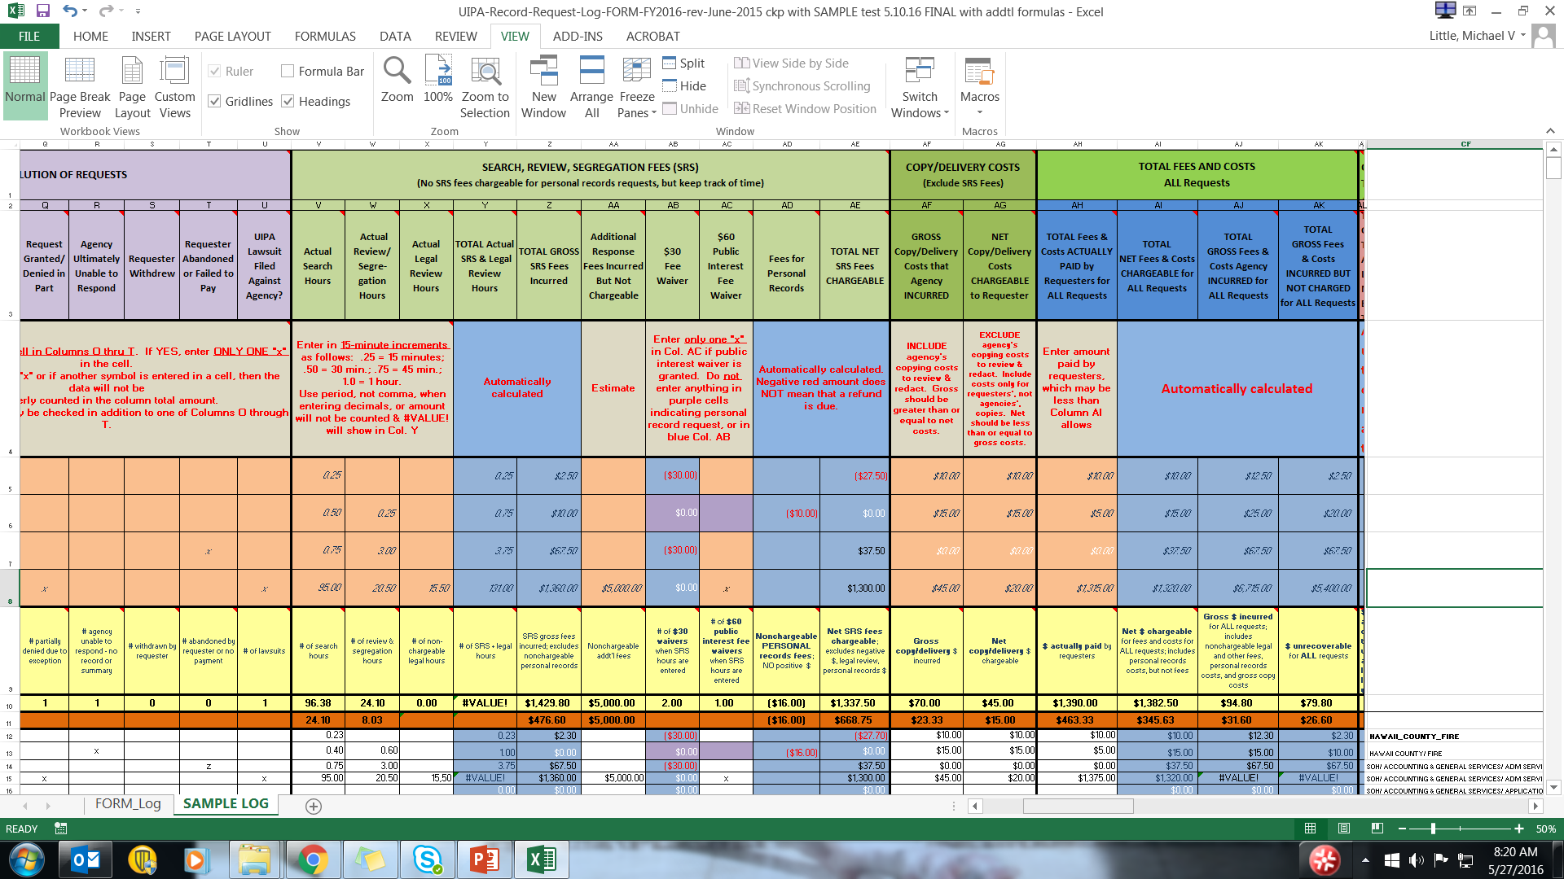
Notes:
Remember that below the column headings are additional instructions for data entry in the affected columns. In this slide, the arrow points to instructions in row 4 showing that SRS time should be entered in .25 increments per hour, so .25 = 15 minutes, .50 = 30 minutes, .75 = 45 minutes, 1.0 = 1 hour. Also, be careful to use a period, and not a comma, when entering decimals. Otherwise, the amount will not be counted and an error message shown as #VALUE! will appear in Column Y and later columns. Remember that the yellow highlighted row of “Totals” is based on the white data entered by the agency from row 12 down. Because data in the white rows of the Sample Log was improperly entered, the yellow “Total” in Column Y shows the error message and the sums do not add up to what is seen in the Examples on this slide.
Entry Tip: If your agency’s yellow highlighted total amounts in Columns V through Y do not end in .25, .50, .75, or zeroes, then you know that someone has inputted the wrong number and has not used .25 increments. Since everything is in .25 increments, there should be no data entries ending in .11, .12, .13, .14, .15, .20, .40, .60, etc. Also, the minimum time that should be entered is .25, since it will take at least 15 minutes or a portion thereof to search for or respond to a request.
The four record request examples show how the agency has properly entered the time it spends in search, review, and segregation (SRS) efforts. Under Column V for “Actual Search Hours,” each example shows varying amounts of time the agency spent on searching to locate and determine if the agency, or another party under the agency’s administrative control, “maintains” the requested record.
Example 1 shows “0.25” for a 15-minute search, which is the minimum time that should be entered. Example 2 shows “0.50” for a 30-minute search. Example 3 shows “.75” for a 45-minute search. Example 4 shows “95.00” for 95 search hours for a complex record request.

Slide 6
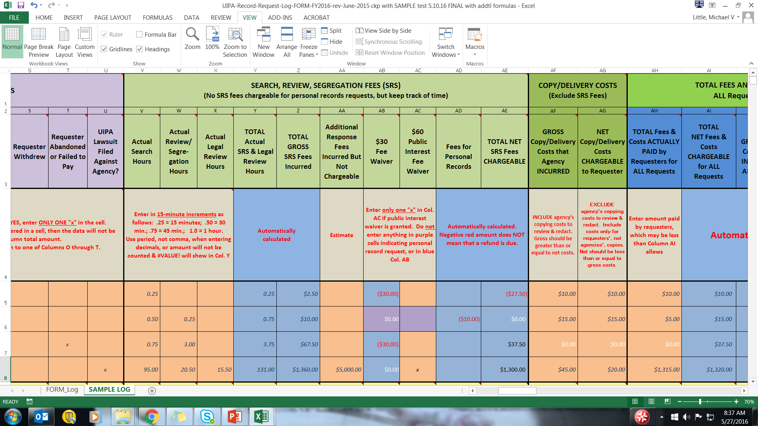
Notes:
Next, in Column W, the agency has entered the time spent reviewing and segregating the records. Under “Actual Review/Segregation Hours,” each example shows varying amounts of time the agency spent to review the record to determine which portions, if any, may be exempt from disclosure, and then redacting the exempt portions.
Example 1 shows no time spent reviewing and segregating. Example 2 shows “0.25” for 15 minutes. Example 3 shows “3.00” for 3 hours. Example 4 shows “20.50” for 20 hours and 30 minutes spent reviewing and segregating a complex record request.

Slide 7
Notes:
Moving over to Column X, the agency has entered the time spent for legal review by its attorney(s). Note that this is not a fee that can actually be charged by an agency under OIP’s current rules, which do not allow an agency to charge for attorneys’ time to research possible exemptions from disclosure or to determine the propriety of the agency’s response. OIP is collecting the legal review data to get a full picture of how much time and resources are being devoted to fulfilling UIPA record requests.
Under “Actual Legal Review Hours,” the first three examples show no time spent for legal review. Example 4, however, which is the complex record request, shows “15.50” for 15 hours and 30 minutes spent for legal review.

Slide 8
Notes:
Column Y shows the “TOTAL Actual SRS Hours” for each of the four examples.
These totals are automatically calculated, by adding the hours inputted by the agency from the previous three columns: search hours, review/segregation hours, and legal review hours. Again, note that this is not the basis for the amount of fees that can be charged to a requester, but Column Y gives a more accurate picture of how much time the agency has actually incurred in responding to the request.
Example 1, the typical record request, shows a total of “0.25” hours, which is 15 minutes.
Example 2, the personal record request, shows a total of “0.75” hours, which is 45 minutes.
Example 3, shows a total of “3.75” hours, which is 3 hours and 45 minutes.
Example 4, the complex request, shows a total of “131.00” hours.

Slide 9
Notes:
In Column Z, the Log has automatically calculated the “TOTAL SRS Fees Incurred” for each of the four examples, showing $2.50, $10.00, $67.50, and $1,360.
These are the total gross fees incurred for Search, Review, Segregation, excluding the legal review time and not accounting for personal records (for which SRS fees may not be charged) or any fee waivers. Again, this is not the amount that may actually be charged by the agency.

Slide 10
Notes:
Column AA is where the agency enters “Additional Response Fees Incurred But Not Chargeable.” Most times, there will be no entry for this column.
But, there may be occasions when an agency incurs additional fees or costs that cannot be recovered by the agency under the UIPA. For example, the agency may incur, but cannot charge for, special counsel’s legal fees or an expert witness’s testimony to defend a lawsuit brought by a requester to compel disclosure. The agency should estimate and list such nonrecoverable fees in this column.
The arrow at the bottom points to the agency’s estimate of additional fees spent in the example of the complex request from the Honolulu News and shows that the agency incurred “$5,000.00” in estimated additional fees.

Slide 11
Search, Review, Segregation Fees (SRS) Q & A
What are fee waivers? The agency must waive the first $30 in fees for search, review, and segregation … OR the first $60 where the agency finds that the requester has met the requirements under OIP’s administrative rules for a public interest waiver.
Notes:
Now, we know what fees the agency has incurred in responding to a request. Next, we need to determine whether any of these fees must be waived.
OIP’s rules provide for two kinds of fee waivers:
The agency must waive the first $30 in fees for search, review, and segregation …OR
the first $60 if a public interest waiver applies. Before granting the request for a public interest waiver, the agency must find that the requester has met the requirements under OIP’s administrative rules for such a waiver, which will be discussed in greater detail shortly.

Slide 12
Search, Review, Segregation Fees (SRS) Q & A
How are $30 fee waivers shown on the Log? The Log will automatically enter the $30 fee waiver as a negative number, which will show up in RED as ($30.00) in column AB.
(But yellow totals in cell AB10 are for the total number of $30 fee waivers, and should be a positive number.)
For a personal records request highlighted in purple, the Log will automatically enter ($0.00) because SRS fees may not be charged.
Notes:
The Log will automatically record a $30 fee waiver, when appropriate, in Column AB, which is why that column is highlighted in blue. Although the waiver is entered as a negative dollar amount so that fees can be properly calculated in later columns, the Column AB “total” highlighted in yellow in cell AB10 will calculate the total number of $30 fee waivers granted by the agency. The “total” in cell AB10 should be a positive whole number.
For personal records requests, which are highlighted in purple, remember that no SRS fees may be charged in the first place. That is why the Log will automatically enter “$.00” in cells in Column AB that are highlighted in purple.

Slide 13
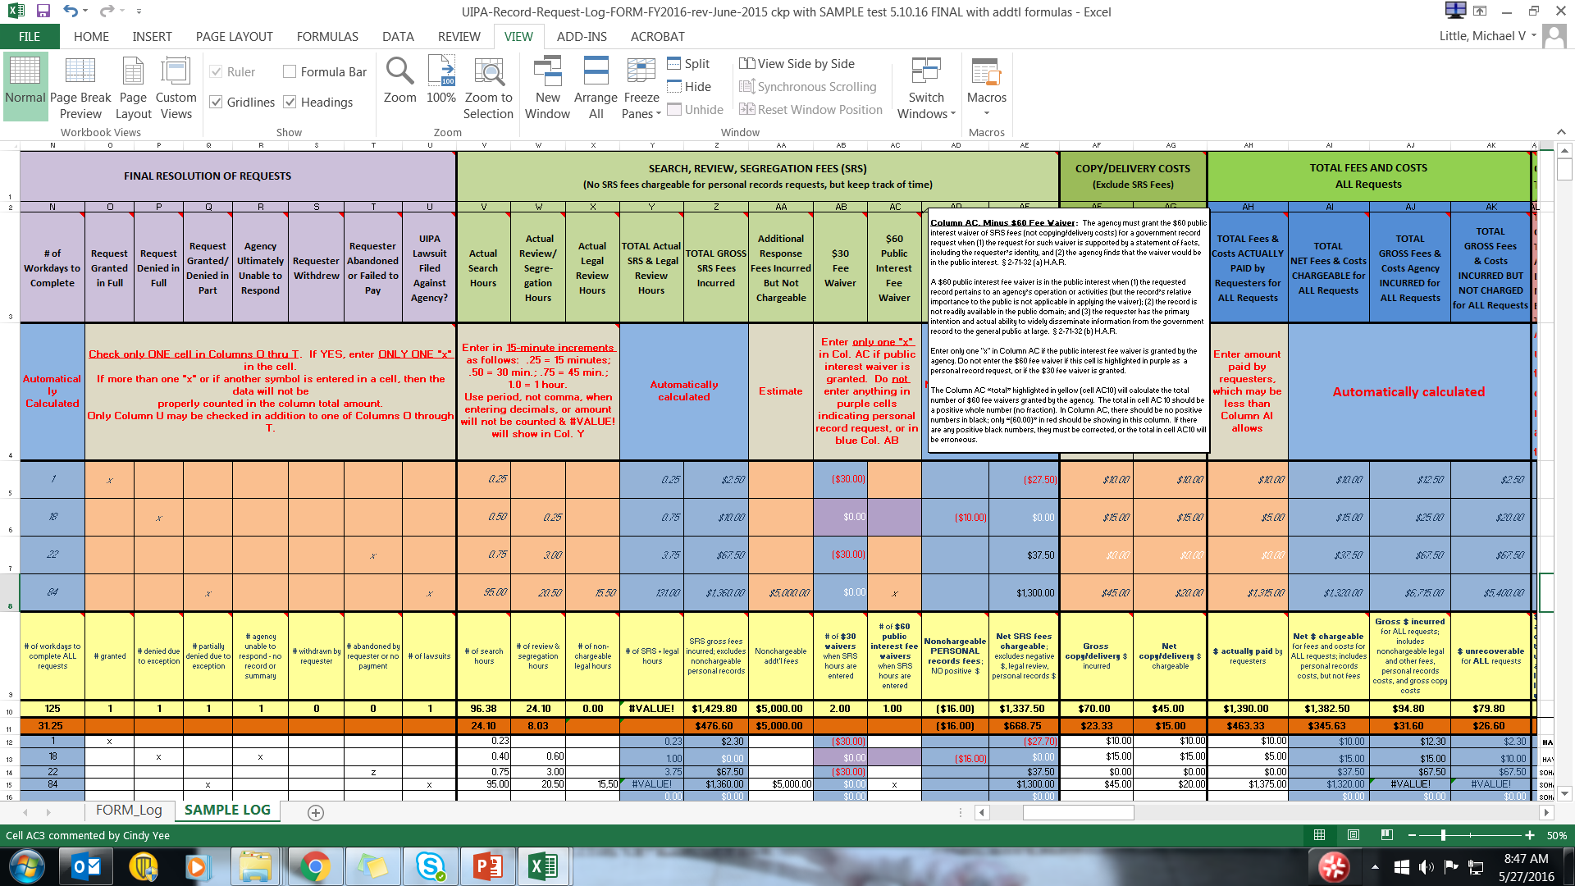
Notes:
Column AC shows the $60 fee waiver, with detailed instructions about when to grant this public interest waiver.
As the pop-up instructions state, the $60 public interest fee waiver must be granted when (1) the request for such waiver is supported by a statement of facts, including the requester’s identity, and (2) the agency finds that the waiver would be in the public interest. § 2-71-32 (a) H.A.R.
A $60 public interest fee waiver is in the public interest when (1) the requested record pertains to an agency’s operation or activities (but the record’s relative importance to the public is not applicable in applying the waiver); (2) the record is not readily available in the public domain; and (3) the requester has the primary intention and actual ability to widely disseminate information from the government record to the general public at large. § 2-71-32 (b) H.A.R.
If the agency enters any SRS hours and grants a $60 public interest fee waiver, then it must enter a single “x” in the appropriate white cell of Column AC. The fee waiver will be factored into the Log’s automatic calculations. The yellow total in cell AC10 will count all $60 fee waivers in Column AC. It will not count an “x” that has been incorrectly entered in a purple personal record cell.

Slide 14
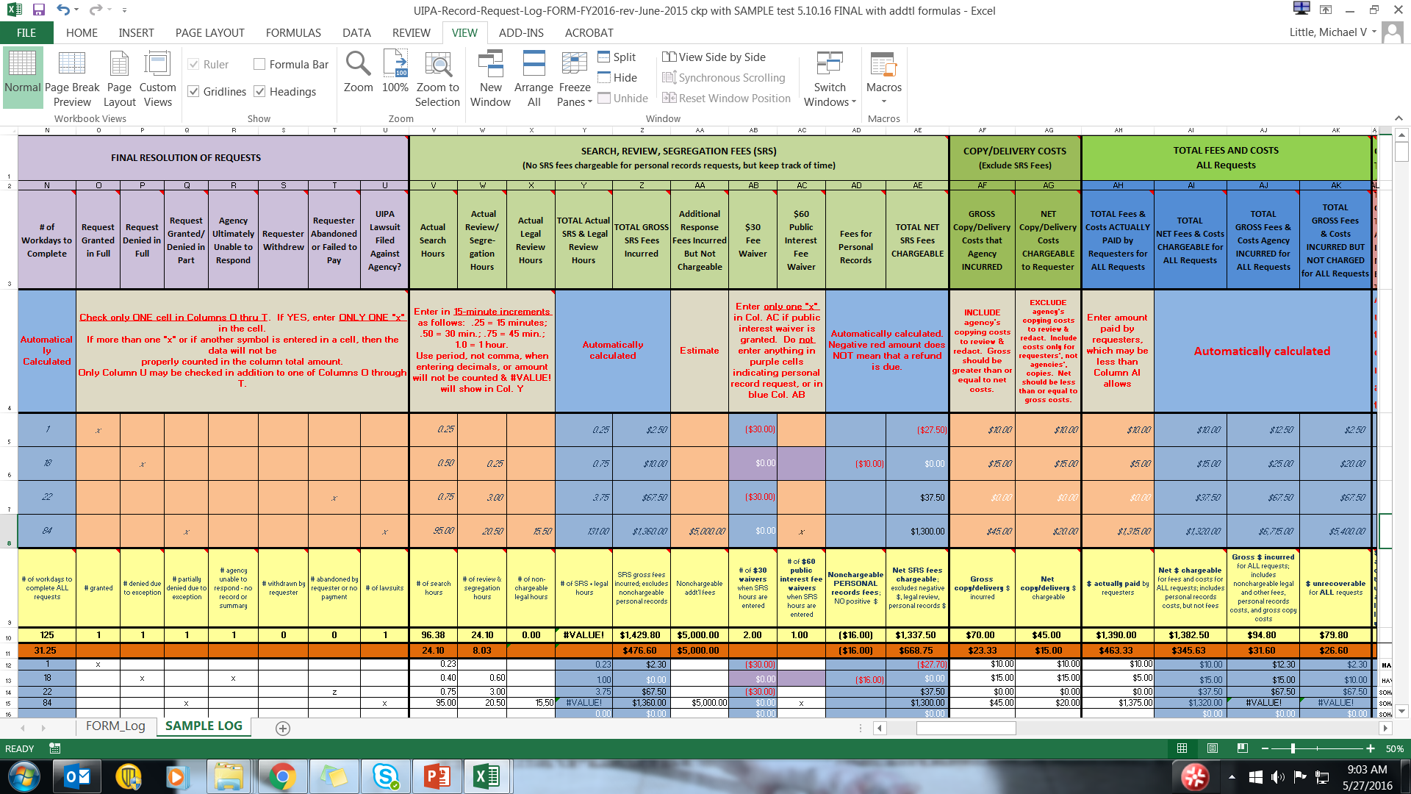
Notes:
Here, in Columns AB and AC, we see how the fee waivers should look.
The Log has automatically entered the $30 fee waiver in Column AB in Examples 1 and 3 (cells AB5 and AB 7). It also automatically entered $0.00 in the purple cell (AB6) of Example 2 to indicate that no fee waiver is allowed for personal record requests.
The agency has entered a single “x” in Column AC for Example 4 (cell AC8) because it granted a public interest fee waiver.
The yellow highlighted “Totals” in Columns AB and AC will calculate the total number of $30 or $60 fee waivers, and not their dollar values. Remember, in this slide, the yellow “Totals” are for the data entries that are in the white rows below, which are different from the highlighted examples.

Slide 15
Column AD: Fees for Personal Records
Will be subtracted from net amounts chargeable in Column AE
CANNOT be charged by the agency
Not a refund to requester
Notes:
Amounts for fee waivers, legal review hours, and personal record requests are not included in the Column AE net amount that an agency can charge for SRS fees, which we will discuss shortly. For now, let’s look at Column AD, which shows “Fees for Personal Records” and make sure that you understand that (1) Column AD’s amounts will not be included in net fees chargeable, (2) the agency cannot charge the requester for Column AD’s amounts, and (3) no refunds of Column AD’s amounts are due to requesters. Based on the search, review, and segregation times that the agency is entering, the Log is simply calculating these nonrecoverable personal record fees in Column AD in order to make other calculations and to provide data that OIP may use in reviewing and developing its administrative rules.
Note that although the agency cannot charge SRS fees for personal record requests, it can still charge for copying and delivery costs, which will be explained later.

Slide 16
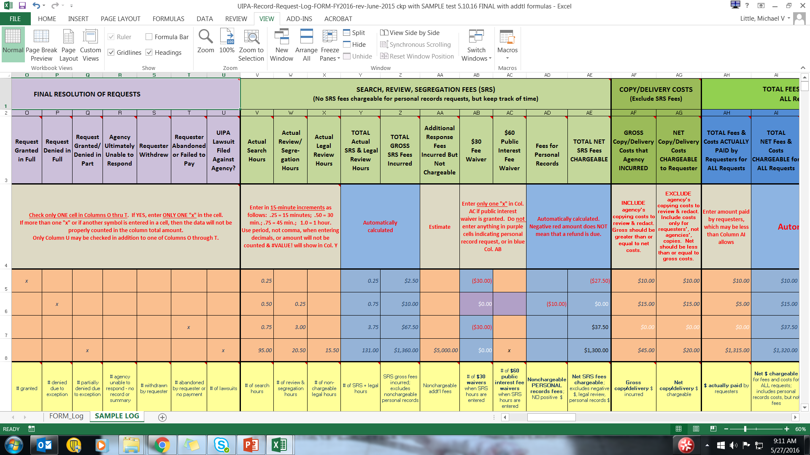
Notes:
Let’s see how the Log looks when a personal record request is entered, as in Example 2. We see that the Log has highlighted in purple Example 2’s cells in Columns AB and AC. In Column AD, we see a negative number in red in parentheses, ($10.00). Remember, this is not a fee that the agency can charge nor is it a refund payable to the requester.

Slide 17
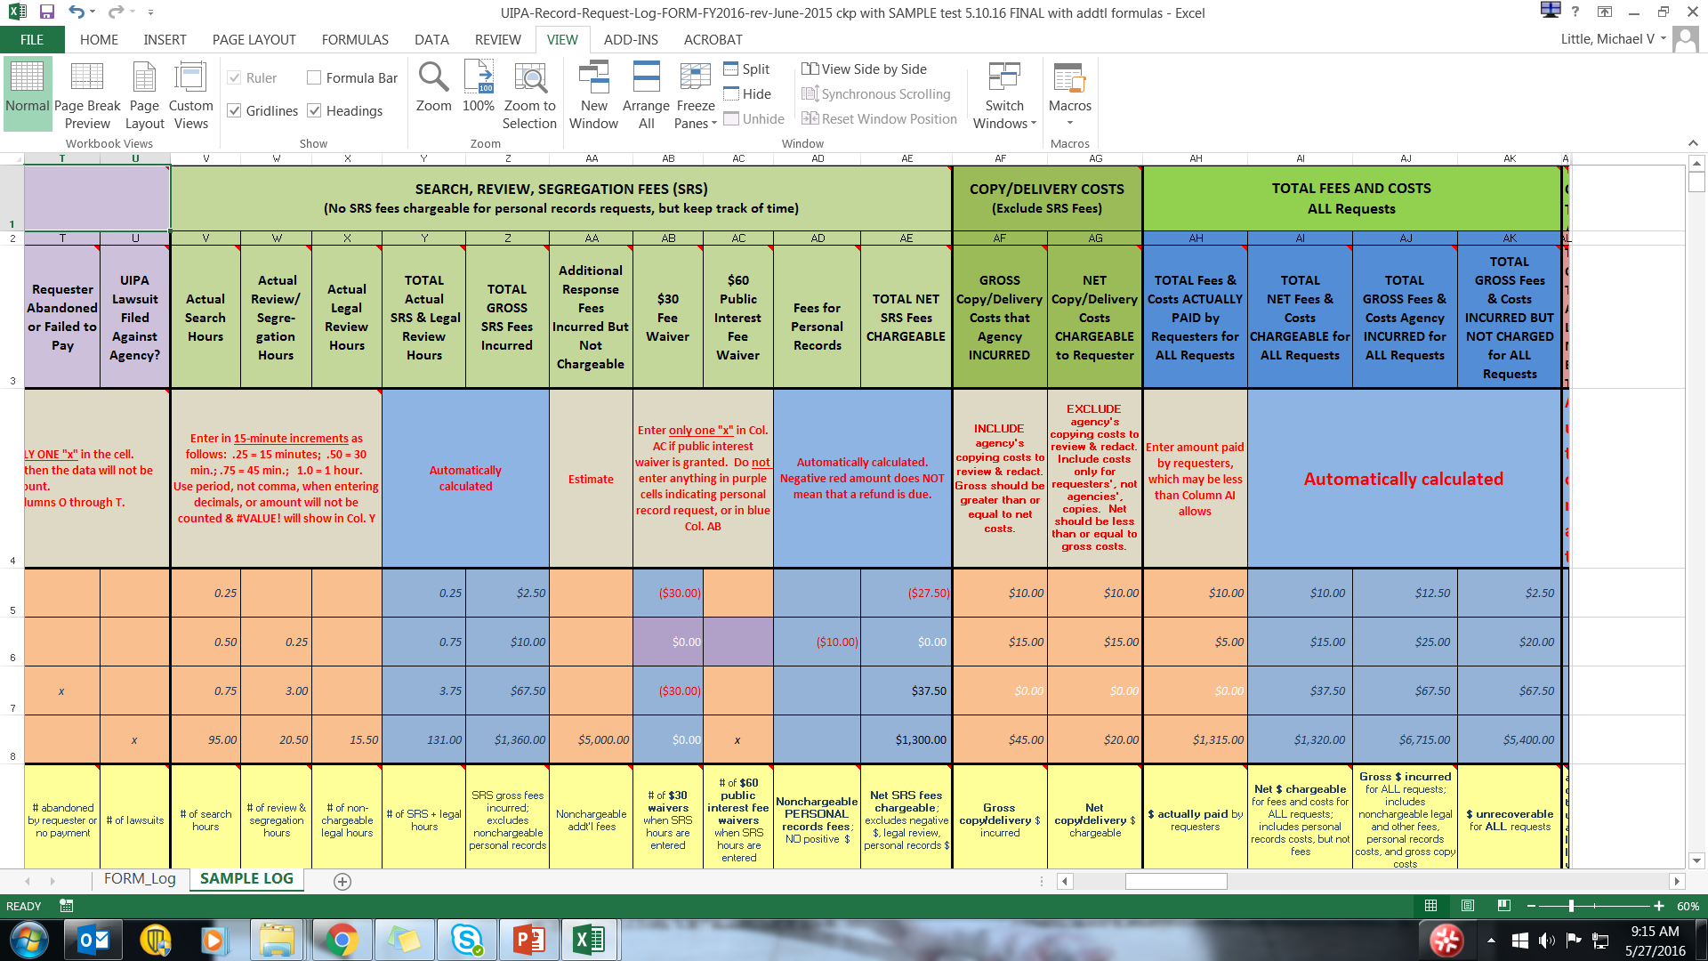

Notes:
What is chargeable to the requester is found in Column AE, where we have the Total Net SRS Fees Chargeable. This amount is based on the SRS times entered by the agency, and excludes amounts for personal records requests, legal review hours, and fee waivers. This column automatically calculates the net amount that an agency may charge in SRS fees.
For our first two examples, no fees are chargeable. The first example of a typical request shows that only $2.50 in SRS fees were incurred, and this falls within the $30 waiver. Although Example 1 shows a negative $27.50 in net fees chargeable, this does not mean that the requester is entitled to a refund. Any negative number simply means that no fees are chargeable.
The second example of a personal record request shows “$0.00” because no SRS fees can be charged.
The third example points to the anonymous request for President Obama’s birth certificate, which is a government records request, not a personal records request. SRS fees of $67.50 were incurred, and the Log automatically subtracts the $30 fee waiver, so the total net SRS fees chargeable to the requester is $37.50.
The next slide explains the SRS fees for the “Honolulu News,” Example 4.

Slide 18
Notes:
The bottom arrow points to the total net SRS fees chargeable in Column AE for the “Honolulu News” request.
Because this was a large, complex request that incurred $1,360 in SRS fees according to Column Z and was eligible for the $60 public interest fee waiver as shown in Column AC, the Log automatically calculated the net fees chargeable by subtracting $60 from $1,360, resulting in total net SRS fees chargeable of $1,300, as you see here in Column AE.

Slide 19

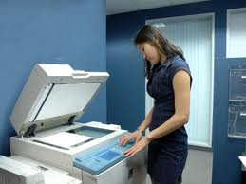
Columns AF & AG: Copy/Delivery Costs HRS Sec. 92-21; HAR Sec. 2-17-19
AF: Gross copy/delivery costs that agency actually incurred, but may not have totally recovered -- Include copies made for redaction
AG: Net copy/delivery costs properly chargeable to requester -- Exclude copies made for redaction -- Include copies made of electronic record if requester wants them faxed, mailed, or provided in a physical form
Notes:
Separate from SRS fees, OIP rules (HAR §2-17-19) allow an agency to recover “[a]ny other lawful fees,” such as copy and delivery costs for responding to a records request. Each agency, not OIP, sets its own schedule of photocopying costs, which is governed by HRS §92-21 and is outside of OIP’s jurisdiction. HRS §92-21 currently requires agencies to charge not less than five cents per copy. It is important to also understand that copying and delivery costs are not subject to the SRS fee waivers found in Columns AB and AC.
Column AF is where the agency enters the gross copy or delivery costs that it incurred. For gross costs, the agency should include all costs of copies, even those made for the agency’s use in redacting the record.
Column AG asks for the net copy or delivery costs that the agency can charge to the requester. For net costs, the agency should exclude extra copies made so that the agency can redact a record – OIP’s rules allow the agency to charge for only the redacted copy that is provided to the requester. Include copies made of an electronic record if the requester asked them to be faxed, mailed, or otherwise provided in a physical form.
The yellow highlighted “Totals” in cells AF10 and AG10 add up the amounts found in the white cells, while the orange highlighted “Averages” in cells AF11 and AG11 calculate the copying and delivery costs per case in which such costs were incurred. The average does not include cases in which no copying or delivery costs were incurred.
Entry tip: Gross copying and delivery costs incurred by the agency should always be greater than or equal to the net costs chargeable to the requester.

Slide 20

Notes:
Let’s look at how copying and delivery costs were entered in the white cells at the bottom of this slide.
The first white entry shows that $10 in gross costs were incurred by the agency in Column AF and that $10 in net costs were chargeable to the requester in Column AG. For the second white entry, $15 in gross costs are shown in Column AF, but that only $5 of that amount was chargeable, as shown in Column AG. This implies that $10 of the total costs were for copies that the agency made for its own purposes to review or redact the record, which the agency could not charge the requester. Only the cost of copying the redacted record for the requester could be properly charged to the requester.
The third white entry shows zero costs. The last white entry shows $20 in gross costs and $45 in net costs.
The yellow highlighted cell AF 10 adds up the gross copying and delivery costs for a total of $45 that was incurred by the agency. The orange average cell in AF11 divides the total by the number of requests in which such charges were incurred, which is 3 not 4, to calculate an average of $15 per case in which costs were incurred. The yellow highlighted amounts in cells AG10 and AG 11 perform the same calculations for the net costs and show $60 in total costs and $20 in average costs. But are these numbers correct?
Remember, the gross copying and delivery costs should always be greater than or equal to the net costs. How can the requester be charged more in net costs in Column AG than the agencies’ gross costs in Column AF?
The information is only as good as the data that is entered. In the fourth white entry, the agency entered wrong data showing $20 in gross costs and $45 in net costs, which is why the Sample Log’s Total and Average show that something is wrong.

Slide 21
Columns AH thru AK: Total Fees & Costs
Agency to input:
Total fees & costs actually paid by requester (AH)
Log automatically calculates:
Total net fees & costs chargeable (AI) – make sure amounts paid in AH do not exceed AI amount
Total gross fees & costs incurred (AJ)
Total gross fees & costs incurred but not charged (AK)
Notes:
Before we explain the other mistakes in the Sample Log, let’s get to the last column for which the agency has to enter data and see how it affects the bottom line in total agency fees & costs for record requests. These statistics will show agencies what it is costing them in total to respond to record requests, and what fees and costs they are actually recovering from requesters.
First, in Column AH, the agency inputs the total fees & costs that were actually paid by the requester and collected by the agency (even if the amounts are deposited into the State’s general fund).
The Log will then automatically calculate the total net fees and costs that may be charged in Column AI. Please compare Columns AH and AI because the amount actually paid in Column AH should not exceed the total net chargeable fees and costs in Column AI.
The Log will also automatically calculate the gross fees and costs incurred by the agency in column AJ and the total gross fees and costs incurred but not charged, in essence, what is unrecoverable, in Column AK.

Slide 22
ENTRY TIP
The calculations and information obtained are only as good as the data that is entered by the agency.
Agencies must properly enter the data, especially in Columns F and K, which identify personal record and complex requests.
Notes:
Please remember this important ENTRY TIP: The calculations and information obtained are only as good as the data that is entered by the agency. Agencies must properly enter the data, especially in Columns F and K, which identify personal record and complex requests. If more than one “x” or any other number, date, or symbol has been mistakenly entered in these columns, the request will not be counted as a personal record or complex request, and fees and costs will not be correctly calculated.

Slide 23
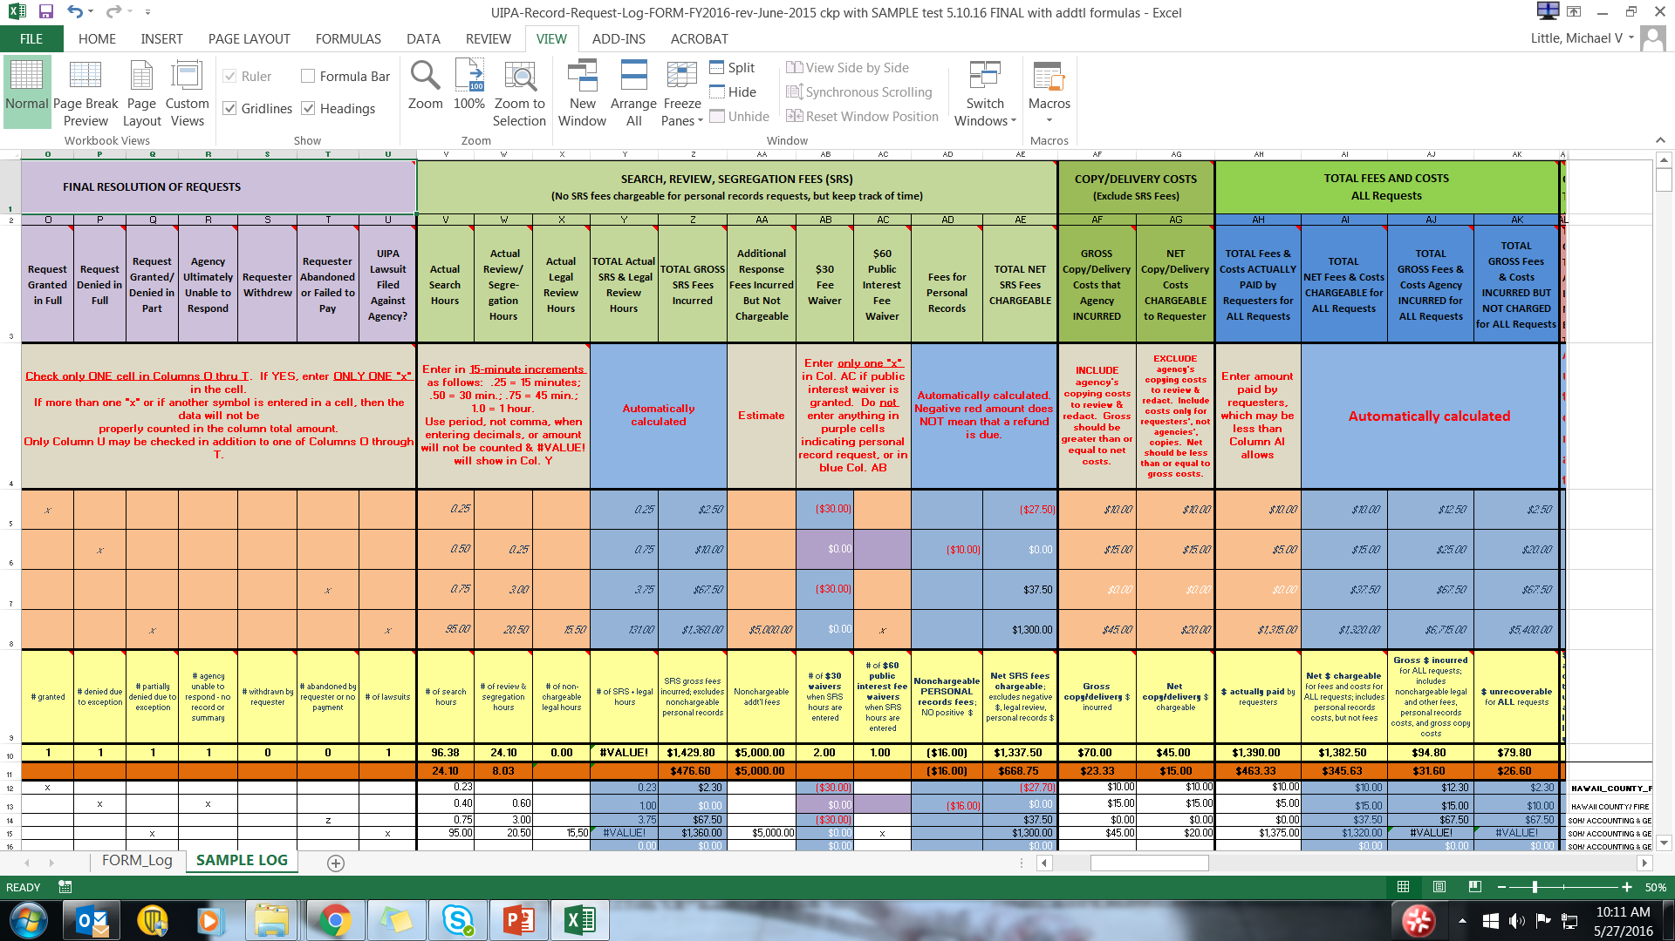
Notes:
Let’s look at the highlighted Examples in the middle of this slide and see how the fees and costs were entered.
In Example 1, a typical request, Column AH shows that the requester actually paid $10 which is also the total net fees and costs that could be charged, as automatically calculated in Column AI. Per Column AJ, the actual total gross fees and costs that the agency incurred is $12.50, so Column AK shows that the agency incurred $2.50 in gross fees and costs that it cannot recover.
By simply entering the amount actually paid in Column AH the Log does the calculations for the other columns in the next 3 examples as well.
The yellow highlighted “Totals” in row 10 will add up the entries from the white columns below, not the ones from the Examples highlighted here. Similarly, the orange highlighted “Averages” in row 11 will provide average fees and costs per request, excluding personal records, based on the entries in the white column entries below. Because the Sample Log entries in the white rows are different from the highlighted Examples, we will not go over the amounts shown here.

Slide 24

The UIPA Log-- Fourth part is:
Identification
Resolution of requests
Fees and costs
4. Time to respond
Notes:
The last part of the Log provides statistical data on how much time an agency takes to respond to record requests. No data is entered by the agency in this part.
There are many additional Columns in the electronic Log that you do not see on the Sample Log, and you do not enter any data in them. Those columns are automatically calculated by the Log based on data that you entered earlier, and they provide important information that OIP will use to calculate fees, costs, payments, completion times, and SRS times, by types of requests. With this data, OIP can measure compliance with the UIPA and can determine if changes to its rules are warranted.

Slide 25
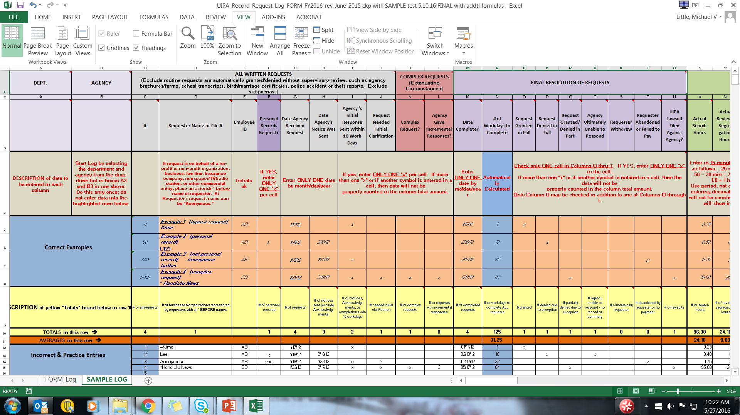
Notes:
Now that you understand how to properly enter data for the Log, let’s go over the mistakes that were made in the white data entry rows of the Sample Log and you can circle them on your own copy.
In the first section for “All Written Requests,” we see that the request by “Kimo” was incorrectly entered with a hashtag or pound symbol instead of an asterisk to indicate that he was making the request on behalf of a business or nonprofit organization. An asterisk was properly entered before the “*Honolulu News” request to show that it was made by a business. Consequently, yellow cell D10 shows that only 1 request was made by a requester on behalf of a business or nonprofit organization.
In Example 2, a personal records request by “Lee,” the requester should have been identified by initials or a file number to avoid having to possibly redact the name later if a request is made for the Log itself.
In Example 3, Column F of the “Anonymous” request was entered incorrectly because “yes” was entered instead of a single “x” to indicate that it was a personal records request. Although the Log can list the personal record requester as being “Anonymous,” remember that personal record requests cannot be made anonymously as the agency must ensure that the requester has the right to access the records being sought. Because of the incorrect “yes” entry in Column F for Example 3, the “Total” in yellow highlighted cell F10 counts only one, not two, personal record requests.
Moving over to the right in Column I, we see that two “xx” was entered incorrectly for the Anonymous request. Because of this, only the single “x” entries for Kimo and the Honolulu News were counted in the total of “2” in yellow highlighted cell I10, and the Anonymous incorrect entry was not included as being a request in which a response was sent within ten work days.
The same problem occurs in Column J, where a question mark was incorrectly entered in the cell for the Anonymous request. Because the Anonymous entry was not a single “x”, the total in cell J10 only counted the single “x” that was correctly entered for the Honolulu News’ request to indicate that it needed initial clarification.
Finally, in the Complex Requests section in Column L, the number “3” was incorrectly entered for the Honolulu News request instead of one “x” so this request was not counted in the total cell above it (cell L10) as being a request requiring incremental responses.

Slide 26

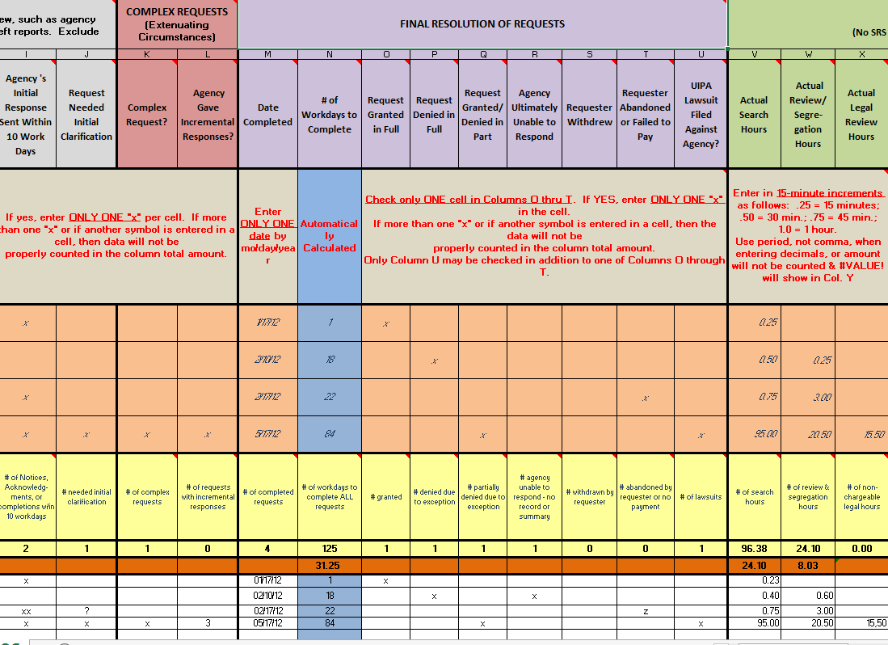
Notes:
Next, let’s look at the mistakes in entering data in the white rows of the “Final Resolution of Requests” section. In this section, Column N is highlighted in blue because the number of workdays to complete the request is automatically calculated by the Log, so no data is entered there by the agency.
The agency, however, erroneously entered data for the second request by Lee (row 13) because an “x” was entered in both Columns P and R, when only ONE of the columns O through T should be checked to show how a request was ultimately resolved. Column P should be checked if the agency denied the request in full because it claimed an exception to disclosure. Column R should be checked if the agency was ultimately unable to respond because either (1) it does not maintain the requested record, or (2) the request requires the creation of a summary or compilation of information that is not readily retrievable. On the other hand, if the agency was initially unable to respond and later obtained the clarification that it needed to complete the request, then it should have checked Column J instead, not Column R. Or if the agency was initially unable to respond and did not receive the clarification that it had sought from the requester, then the request could be deemed abandoned and Column T should be marked with a single “x”, not Column R. Here, however, the agency erroneously entered a “z” instead of one “x” in Column T, so this request was not counted in the “Total” in yellow highlighted cell T10.
Unlike the earlier mistake, note that the last request was properly entered in two columns. Column Q was marked with a single “x” to indicate that the request was partially granted. Column U could also be checked because a UIPA lawsuit was filed against the agency by the requester.

Slide 27
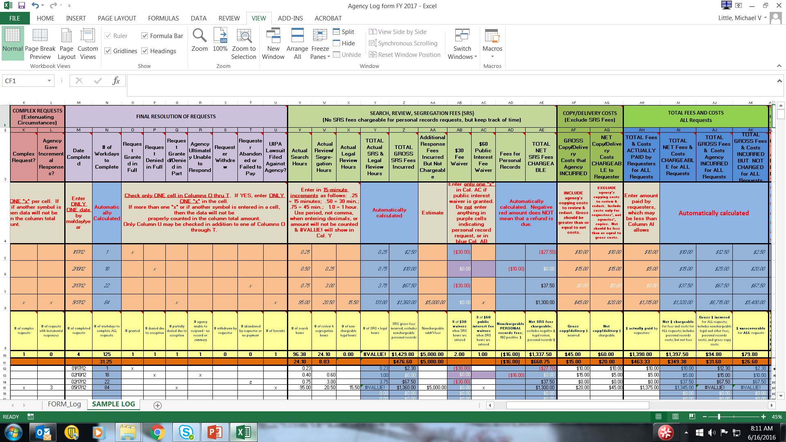
Notes:
Moving on to the SRS Fees and Costs section, what are the incorrect data entries in the white rows of the Sample Log at the bottom of this slide? Let’s start with Columns V through X, where the instructions in row 4 remind you to “Enter in 15-minute increments,” such as .25, .50, or .75. Obviously then, search hours were incorrectly entered in the white rows of Column V as .23 and .40. Similarly, in Column W, there is an incorrect entry for .60. And in Column X, the one entry was incorrectly entered as 15 comma 5. Because the decimal was incorrectly entered with a comma, instead of a period, in Column X, the error message #VALUE! appears in Column Y and later columns.

Slide 28
Notes:
Using the same slide, let’s look at the instructions on row 4 for fee waivers in Columns AB and AC. Note that Column AB is highlighted in blue, so you do not enter anything there. Also, nothing is entered by you in the purple cells, which identify personal record requests. You just have to enter a single “x” in Column AC if SRS hours have been entered and the agency is granting a $60 public interest fee waiver. The yellow cells AB10 and AC10 will total the number of fee waivers granted by the agency.
Moving over to Columns AF and AG, we see in the instructions in row 4 that net copying and delivery costs should be less than or equal to gross costs. The last request in the white cells at the bottom of the slide incorrectly entered net chargeable costs of $45 in column AG, which is more than the gross costs of $20 in column AF. These numbers have been obviously transposed because the NET costs that are chargeable should always be less than or equal to the GROSS costs incurred.

Slide 29
Notes:
Finally, let’s look at the last data entry that you will make. In Column AH, we see in the last white cell on the far right that the requester actually paid $1,375, which is $30 more than the allowable charge of $1,345 that was automatically calculated in blue cell AI15. This is another obvious mistake because, as the instructions in row 4 state, the agency cannot charge the requester more than the allowable charges calculated in Column AI.
As you see by comparing the sample entries in the white cells with the Examples highlighted above them that the data was entered incorrectly, which is why the fees and costs calculations provide incorrect information. REMEMBER, THE INFORMATION PRODUCED BY THE LOG WILL ONLY BE AS GOOD AS THE DATA THAT IS PROPERLY ENTERED BY THE AGENCY.

Slide 30

Submitting the Log and Checklist
Submit your completed Log and Checklist to OIP (oip@hawaii.gov) by the January 31 and July 31 deadlines each year.
Before submitting to OIP your agency’s completed UIPA Record Request Log, please review the data entries, correct any data entry errors, and complete the Checklist that must accompany the Log.
OIP will upload your Log totals and routine requests estimate to the Master Log on data.hawaii.gov and will prepare State and County reports posted at oip.hawaii.gov
Notes:
After you’ve entered all the data and your agency is ready to submit the Log to OIP, what happens?
Remember, your agency’s Log must be accompanied by a Checklist and submitted to OIP, through your UIPA Coordinator, by January 31 and July 31 each year. Before submitting the Log, please go through the Checklist to make sure that there are no data entry errors on the Log.
After receiving all agencies’ Logs and Checklists, OIP will upload the data summaries onto the Master UIPA Record Request Log at data.hawaii.gov. OIP will also summarize the year-end data in two reports, one for the state data and one for the county data, which will be posted on OIP’s Reports page at oip.hawaii.gov. OIP encourages you to review the reports to see how your agency compares to other departments, Counties, or the State as a whole and so that you can see how the data you are entering on the Log provides important measures of government transparency and accountability.

Slide 31
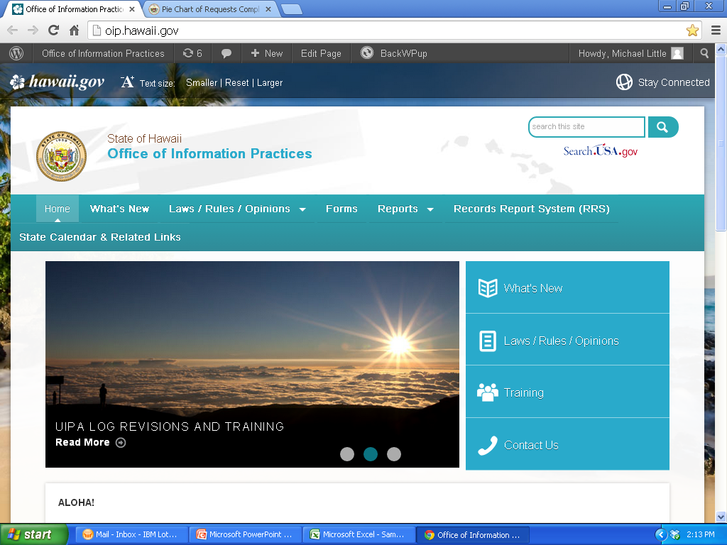
Notes:
Now that you’ve been trained to fill out the Log, where do you go for help when you’re actually doing it? Remember that you have some instructions in the Log’s headings, as well as more detailed pop-up instructions. This power point presentation, with a complete transcript on the “Notes Page,” is also posted onto OIP’s website at:
oip.hawaii.gov
Also, on OIP’s website, the following help is available:
A full set of written UIPA Log instructions;
Frequently Asked Questions about the Log;
A “Tip Sheet” with helpful hints based on users’ experiences with the Log; and
The Log Process Chart, which is a handy cheat sheet to quickly walk you through the procedures.
To get to OIP’s website, simply go to oip.hawaii.gov. Click on the Training link on the right side, and look under the UIPA section for the UIPA Record Request Log training. Or, if you want basic training on the UIPA law itself, and not the Log, you can find a different presentation, the UIPA Guide, Quick Reviews on various issues, and other training materials there on OIP’s website.

Slide 32



Need Help?
Call OIP (808) 586-1400
E-mail: oip@hawaii.gov
OIP website: oip.hawaii.gov
What’s New e-mails
Notes:
In addition to OIP’s website, you can get help from OIP’s staff and attorneys by calling area code (808) 586-1400 or emailing oip@hawaii.gov.
And to keep up with news concerning the UIPA and Sunshine Law, be sure you’re receiving OIP’s What’s New e-mails. If you’re not receiving them through your UIPA Coordinator, you can e-mail oip@hawaii.gov and ask to be placed on the What’s New list.
OIP welcomes your comments on this training and we hope that we have answered all of your questions about how to fill out the revised UIPA Record Request Log. Thank you for attending this training session and for your work in ensuring the public’s right to open records and government transparency.

