Slide 1

UIPA Record Request Log
2016 Update
Hawaii’s Public Records Law
Chapter 92F, HRS
Notes:
(June 2016)
Welcome to OIP’s 2016 Update for the UIPA Record Request Log for state and county employees. I am Cheryl Kakazu Park, Director of the state Office of Information Practices, also known as OIP.
Before I start, please be aware that the complete written transcript of this training is available on the “Notes” page of the power point presentation posted on OIP’s Training page at oip.hawaii.gov, where the new Log form, written Instructions, Checklist, Frequently Asked Questions, and other training materials are also available. There is a new Sample Log in PDF form on the training page, which is preformatted for you to easily print out, preferably in color. You should print out the Sample Log as well as the Checklist form to reference during this training. On the “Reports” page of OIP’s website, you’ll also find the OIP Reports summarizing the results of the State or Counties’ FY 2015 Logs, which will be discussed during this training, but need not necessarily be printed out.
I’d like to start now by thanking you for helping to keep TRACK of the record requests received by your agency and for providing the Log data that has given us objective and useful information on how the state and county governments are complying with their responsibilities under Hawaii’s Uniform Information Practices Act (UIPA). OIP expects to use the Log data collected to review, revise, or develop administrative rules and procedures.

Slide 2
Today’s training is not basic training on UIPA or Log. Will:
  Update on changes made to the Log and procedures, effective June 2016
  Summary of OIP’s Reports of the State and Counties’ FY 2015 year-end results
Notes:
Today’s training will not be basic training on the UIPA or on how to enter data on the Log, and it assumes that you have experience entering data or reviewing your agency’s Log. The purpose of today’s training is to update you on changes that have been made to the Log and procedures effective June 2016. In the second half of this training, I’ll also summarize OIP’s Reports of the State and Counties’ FY 2015 year-end results, so that you can see how your efforts are providing objective data as to how the UIPA is working in Hawaii and how you are helping to provide accountability and transparency to the public.

Slide 3

Overview
What’s New?
First, to improve and streamline the reporting process for agencies, OIP will be uploading the totals from all agency Logs to the Master Log on data.hawaii.gov, relieving the agencies of this task.
  Beginning in July 2016, agencies will submit their UIPA Logs to OIP.
  OIP will review and upload the totals onto data.hawaii.gov
Notes:
What’s new? First, to improve and streamline the reporting process for agencies, OIP will be uploading the totals from all agency Logs to the Master Log on data.hawaii.gov, thus relieving the agencies of this task. Beginning in July 2016, agencies will be submitting their entire UIPA Logs, not just the data summaries, to OIP through their UIPA Coordinator. OIP will upload the summaries from the agencies’ Logs onto the Master Log at data.hawaii.gov, so the agencies no longer have to do this step.
.

Slide 4

Overview
What’s New?
Second, OIP has created a new 2-page
Checklist to accompany agencies’ Logs:
  Lists 17 Log items and tips to review
  and check off before submitting to OIP
  with the Log.
  Different Checklists for FY 16 vs. FY 17
Notes:
Second, to help ensure that the data provided by the agency has been properly entered, the agencies must submit a new 2-page Checklist to accompany their Logs. The Checklist includes agency contact information and a list of 17 tips to ensure that data has been properly entered on the agency’s Log.
The Checklist must be used with the year-end Logs for FY 2016, which must be submitted by July 31, 2016. Since OIP will be doing the uploading, the date for submission of the year-end Log has been moved up by a month. The form for the Checklist to accompany the FY 2016 year-end Logs (which are due to OIP by July 31, 2016) is already posted on OIP’s website at oip.hawaii.gov. and can be accessed through either the Forms or Training pages.
Because the FY 2017 Log form that agencies will begin using on July 1, 2016 has been revised, there is a different Checklist that must accompany the Logs for FY 2017 on. The FY 2017 Checklist will replace the FY 2016 form and will be posted on OIP’s website in August 2016.

Slide 5
Overview
What’s New?
Third, OIP has revised the FY 2017 Log:
  Routine requests have been clarified
  Enter * before name of business or nonprofit organization
  Use initials or file number for personal record requester names
  Enter “x” in column U if a lawsuit is filed by or against the agency
  Columns remain in same order & collect same data.
Notes:
Third, the revisions to the Log form for FY 2017 should make it easier for you to enter data. In brief, OIP has made changes to some formulas, instructions, or descriptions on the Log, but the columns remain in the same order and collect the same data. For data entry purposes, the main changes to the Log are:
1. “Routine requests” have been clarified to be requests that are automatically granted or denied without supervisory review, and also includes routine interagency requests between government agencies.
2. In column D, an asterisk * should be added before the name of a requester who is acting on behalf of a for-profit or non-profit organization, business, law firm, insurance company, newspaper/TV/radio station, or other commercial entity. As for personal record requesters, use only their initials or file numbers, and not their full names.
3. Column U is clarified to require one “x” to be entered if a lawsuit is filed by or against the agency concerning the record request.

Slide 6
Overview
What’s New?
Fourth, OIP has made other changes to the FY 2017 Log’s format, formulas, and later columns that do not affect data entry by agencies.
Since you don’t need to enter data after Column AH, the Sample Training Log worksheet and printable version have been shortened and do not show all columns.
Log form itself is an Excel spreadsheet with all columns that contain necessary statistical information for OIP – do not eliminate columns from agency’s Log that will be submitted to OIP
Remember: Enter data only in white cells up to Column AH
Notes:
Fourth, OIP has made other changes to the FY 2017 Log’s format, formula, and later columns that DO NOT AFFECT DATA ENTRY by the agencies, and OIP has shortened the training materials.
Although all columns remain in the Excel version of the Log that you can see on your computer, you do not enter any data after Column AH for the actual amounts paid by requesters, which you must compare to Column AI. Since you don’t need to see any of the later columns, the Sample Training Log worksheet and its preformatted printable version have been shortened and do not show all cells.
Remember that the Log form itself will still contain all columns as they are necessary for the statistical information that OIP requires, and the form must be submitted to OIP intact. Do not eliminate any columns from the Log form that will be used by the agency and submitted to OIP.
Remember, too, that you do not have to enter any data after Column AH or look beyond Column AI. The Log contains mostly colored areas and very few white cells – remember, you only enter data in white cells, and not even all of them.

Slide 7
Overview
OIP’s reports on the FY 2015 UIPA Logs: highlights of how the state and county agencies are reporting their UIPA record requests:
  Numbers and types of requests
  Time to complete
  Outcomes
  Fees and costs
Notes:
Finally, after discussing the changes in the Log and procedures, this update will show you how the data being collected on the Log is helping to keep state and county governments open and accountable. The second half of today’s training will show you how the data you are collecting has been incorporated into the OIP reports for the FY 2015 UIPA Logs.
The OIP Reports show the overall picture of how many and what types of requests the state and county agencies are reporting, how long the agencies are taking to complete record requests, and the various outcomes, fees and costs of the UIPA requests. Rather than relying on individual or unsupported complaints, OIP now has objective data to see, for example, whether agencies are taking too long to respond, denying too many requests, or charging too much for records. OIP will be considering the data when it reviews its administrative rules for revisions, which may include changes to the fees and waivers.
Today, we want to familiarize you with the Reports, without going into every detail. It is not necessary to print out the Reports themselves for this training, unless you want to more closely examine how your agency compares to other government agencies.

Slide 8
Checklist
Using the Checklist
  Begins in July 2016.
  Can be found on OIP’s Forms or
  Training pages at oip.hawaii.gov.
  Two forms:
    FY 2016: For reporting FY 2016 in July 2016, use the FY 2016 Checklist and the FY 2016 Log form.
    FY 2017: For requests received in FY 2017, use the FY 2017 Log form and the FY 2017 Checklist.
Notes:
Let’s get into the details of today’s training by explaining how to use the Checklist that must accompany your agency’s Log, which will be submitted to OIP through your UIPA Coordinator, beginning in July 2016. Start by making sure that you are using the correct Checklist form, which can be found on OIP’s Forms or Training pages at oip.hawaii.gov.
Note that for the July 31, 2016 deadline for submission to OIP, agencies will be turning in their FY 2016 Logs – they do not have to use the newly revised Log form for this submission. The FY 2016 Checklist is designed for the FY 2016 Log, and it will be taken off the OIP website and replaced in August 2016 with a new FY 2017 Checklist that will refer to changes made to the FY 2017 Log. The only differences between the two Checklists are in item 5 regarding the Requesters’ names and item 15 regarding fee waivers.

Slide 9
Checklist
Agency contact information
This checklist was prepared by:
Name: _________________________
Tel.: ___________________________
E-mail: ________________________
My UIPA coordinator is: ______________
Notes:
Both Checklists start off with an “Instructions” box and then ask for the name and contact information of the person who prepared the Checklist and of the UIPA Coordinator.

Slide 10
Checklist
Department & agency
The attached UIPA Log is for:
State___; or County: Honolulu___; Hawaii___; Kauai___; Maui___
Department: ________________
Agency: ____________________
FY: _________
For requests received from July 1 thru June 30, 20___
(due July 31), or July 1 through December 31, 20___
(due January 31).
Notes:
In case it is separated from the Log itself, the Checklist also asks you to identify the Log to which it relates.

Slide 11
Checklist
#1 Routine requests
Enter the estimated number of routine
record requests received by your agency: ______________.
Routine requests are requests that were made orally or in writing and were automatically granted or denied without supervisory review.
Notes:
The first question on the Checklist asks for an estimate of the number of routine requests received by the agency during the fiscal year. Routine requests are oral or written requests that are automatically granted or denied without the need for supervisory approval, and with or without payment of a fee, such as agency forms and brochures, school transcripts, birth or marriage certificates, and police accident or theft reports. Routine requests should not be logged, as they could skew the Log data because of their substantial numbers in comparison to formal UIPA record requests.
Nevertheless, it is still important for agencies to provide OIP with a reasonably accurate estimate of the number of routine requests that they handle in order give a complete picture of the services and accountability that they render to the public. For example, in FY 2015, the Honolulu Police Department (HPD) logged only 42 of the City and County of Honolulu’s 1,026 formal UIPA requests. Although only 42 formal record requests were logged, the HPD also handled an estimated 30,000 routine requests that were granted or denied by clerks, without supervisory review, such as requests for accident and theft reports. Knowing the number of estimated routine requests gives a more complete picture of what HPD’s Records Division does, without overwhelming and skewing the County’s overall results for all departments.

Slide 12
#1 Routine requests
Requests between government agencies may be routine if they are frequently or typically granted as part of a process or requirement for a contract, grant, appropriation, or statute.
But infrequent or atypical government requests should be logged.
Subpoenas or discovery of records in court cases are not logged or counted as routine requests
Notes:
Requests between government agencies might be considered routine if they are frequently or typically granted as part of a normal process or requirement for a contract or grant. For example, agencies are routinely asked to submit invoices by other agencies to document procurement. The Auditor routinely asks for an agency’s policies during an audit. The federal government may routinely require certain data or reports to be submitted as part of a federal grant. These are routine requests.
But if a request by a government agency is an infrequent or unusual one, then it is not routine and should be reported on the Log. For example, most agencies infrequently receive requests from legislative committees or individual legislators, so these requests should be reported on the Log.
Subpoenas or discovery of records in court cases are not to be logged or included in the estimate of routine records.

Slide 13
#1 Routine requests
Agencies have their own methods of tracking or estimating routine requests.
Enter estimated number of routine requests in question one of the Checklist.
Notes:
It is up to the agency to keep track of the number of routine requests that it handles each year. Some agencies do it through their accounting systems, based on their charges for requested records. Others might do something as simple as keeping a dedicated notepad to log the number of routine requests it responds to each year. A few might even use the Log form to help track routine requests – but the titles of those Logs used should clearly identify them as being for routine requests and should not be submitted to OIP.
Regardless of how you collect the data, all OIP wants is for the agency to provide its estimated number of routine requests in item one of the Checklist. Once OIP compiles the total number of routine requests provided by all agencies, the public will have a better understanding of what the agencies do and what services the public’s tax dollars are paying for. Rather than thinking that all state agencies received only 2,188 record requests as reported on their Logs for FY 2015, the public probably would have a different impression of how government is providing information and accountability when they realize that there were over 87,000 routine requests for records also made that year, a figure which OIP suspects is still underreported.

Slide 14
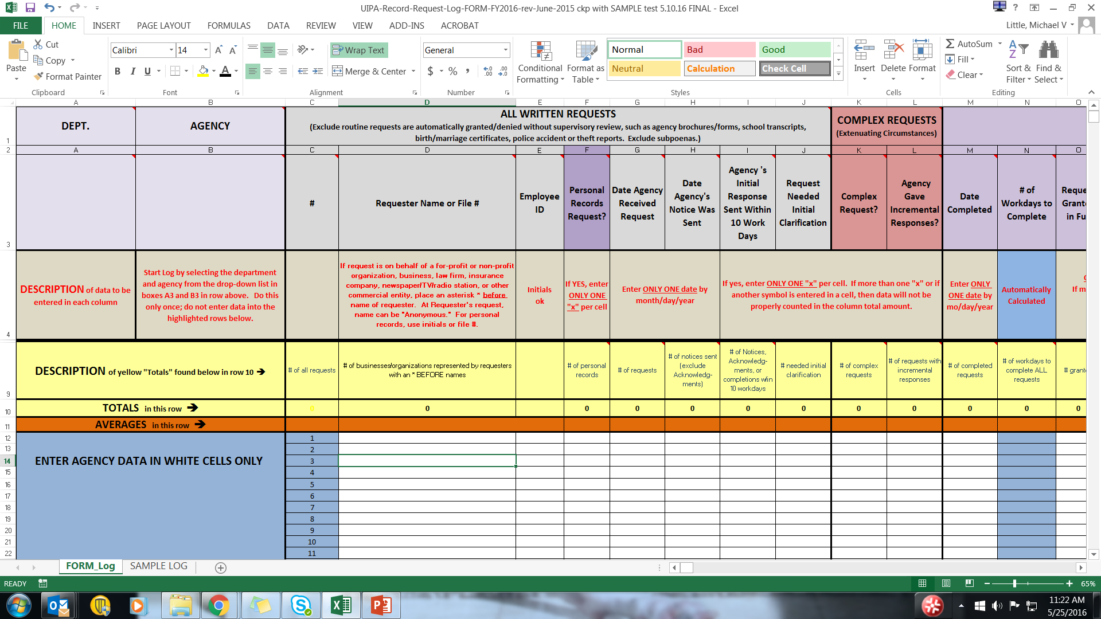
Checklist
#2 Used the
correct Log form
Used the correct Log form for the correct FY,
which can be found on OIP’s training page
(http://oip.hawaii.gov/laws-rules-opinions/uipa/uipa-record-request-log/).
Did not use the Sample Log.
Notes:
The second question in the Checklist is whether you used the correct Log form for the correct FY. What the agency may have in its files could be outdated. The Log that the agencies should use beginning July 1, 2016 is the FY 2017 Log found on OIP’s Forms and Training pages at oip.hawaii.gov.
Also, remember that the Log form contains two worksheets. One is the actual Log form to use. The other worksheet is the Sample Log, which contains deliberately erroneous entries, and is for training purposes only. Do not use the Sample Log or try to enter data into the colored section showing the four Examples.

Slide 15
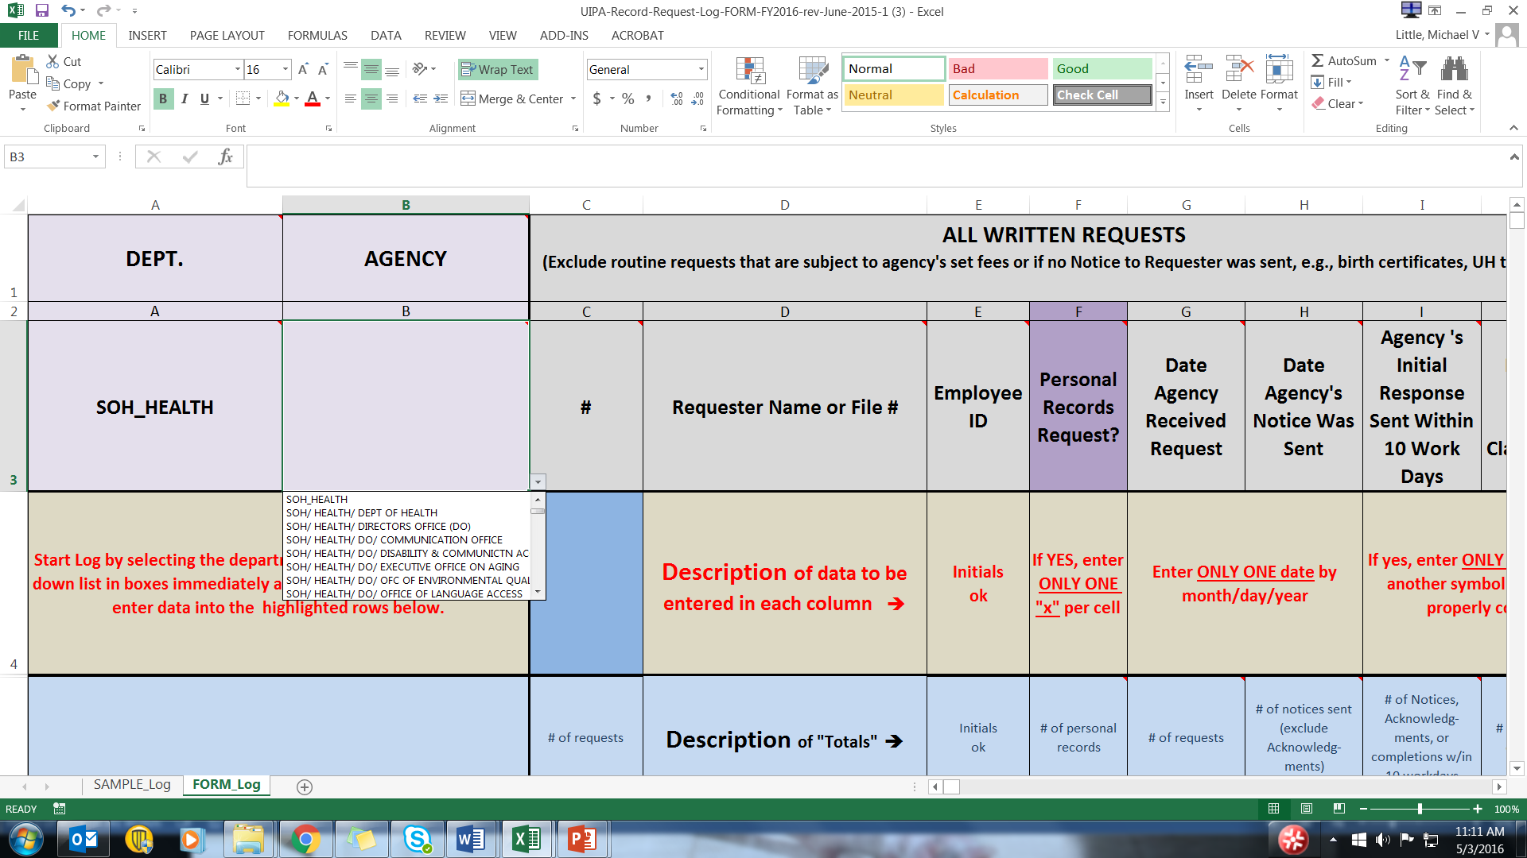

Checklist
#3 Department name
& agency name
Used the drop-down lists to enter
department name and agency name
in columns A & B.
Notes:
The third question in the Checklist asks if you used the drop-down lists in Columns A & B to populate the department name and agency name shown on the Log.
If your agency is not on the drop-down list, then call OIP for help.

Slide 16
Checklist
#4 Entered data
in the white cells
only
  Data was not manually entered in the colored cells, which are are instructions, headings, or automatically calculated by the Log.
Notes:
The fourth question on the Checklist is whether data has been entered by the agency in white cells only. All the colored cells are automatically calculated by the Log, so the agency should not try to change them or enter data there.
Think of all those colored cells as your “friends” to walk you through the process. They provide short descriptions of the data being sought, instructions on how to enter the data, and automatic calculations. For example, if your agency entered the data correctly, Column AI will calculate how much your agency can charge requesters.

Slide 17
Checklist
#5 Requester’s Name:
  Entered Requester’s name, initials or file number
  in column D.
  Name can be “Anonymous” at Requester’s request.
Notes:
The fifth question on the Checklist is whether the Requester’s name, initials, or file number was entered in Column D, and notes that it can be “Anonymous” at the Requester’s request. Remember that although the Requester may be listed on the Log as “Anonymous” for personal record requests, the request cannot be made anonymously because the agency needs to verify that the Requester has a right to the personal records being sought.
You can still use full names for other requests that are not for personal records because those names are generally not redacted if a request is made for the Log itself.
Although OIP will delete all requesters’ names before uploading totals onto the Master Log on data.hawaii.gov, OIP is not responsible for redacting the names if a request is made for the Logs themselves. Therefore, it is important for the agencies to check Column D carefully before submitting their Logs to OIP, to make sure that they entered the names properly. Again, remember to use only initials, the file number, or “Anonymous” to identify personal record requesters.

Slide 18
Checklist
Note: New in FY 2017
(for record requests received
July 1, 2016 to June 30, 2017):
    Requester’s Name:
    One asterisk (*) was added before the name, initials or file number in column D if it could be determined that the request was made on behalf of a for-profit or non-profit organization, business, law firm, insurance company, newspaper/TV/radio station, or other commercial entity.
Notes:
For FY 2017 on, Checklist item 5 was changed to remind you that an asterisk * should be placed before the Requester’s name, initials, or file number in Column D, if it could be determined that the request was made on behalf of a for-profit or non-profit organization, including an advocacy group, business, law firm, insurance company, newspaper/radio/TV station, or other commercial entity. This information is optional, and not required by law, but will help OIP to more accurately complete the Table 10 Supplement to its annual report of the Log’s results, which shows the amounts over $50 that are paid by Requesters and will be discussed later in this training.

Slide 19

Checklist
#6 Personal
record request
  Entered one “x” in column F if the request was for a personal record “about” the individual requesting the record.
  (If properly entered, corresponding cells in Log columns AB and AC highlighted in purple.)
Notes:
For Checklist item 6, please be sure that only one “x” was entered in Column F if the request was for a personal record “about” the individual (a real person) requesting the record.
If properly entered, the corresponding cells in columns AB and AC of the Log will be highlighted in purple. Also, as described earlier, the Requester’s name in Column D should be initials, file numbers, or “Anonymous,” and not a business or organization’s name.

Slide 20

Checklist
#7 Date agency
received request
  Entered the date by month/day/year
  (e.g., 7/1/15) in columns G and H
  Column G date of receipt falls within the period being reported on the Log.
Notes:
For Checklist item 7, please be sure that the dates in Columns G and H are entered in the proper format as month/day/year. Also be sure that the date in Column G, when the agency received the request, falls within the reporting period of the Log.

Slide 21
Checklist
#8 Date agency sent notice;
initial response sent within
10 work days; initial clarification
needed
  Entered one “x” and not dates in column I if the agency sent its initial response within 10 work days.
  Entered one “x” and not dates in column J if the agency needed initial clarification of a request.
Notes:
For Checklist item 8, please be sure the Columns I and J contain only one “x” if applicable, and no dates. A single “x” should be in Column I if the agency sent its initial response within 10 work days. A single “x” should be in Column J if the agency needed initial clarification of a request. Again, no dates should be entered in Columns I or J.

Slide 22
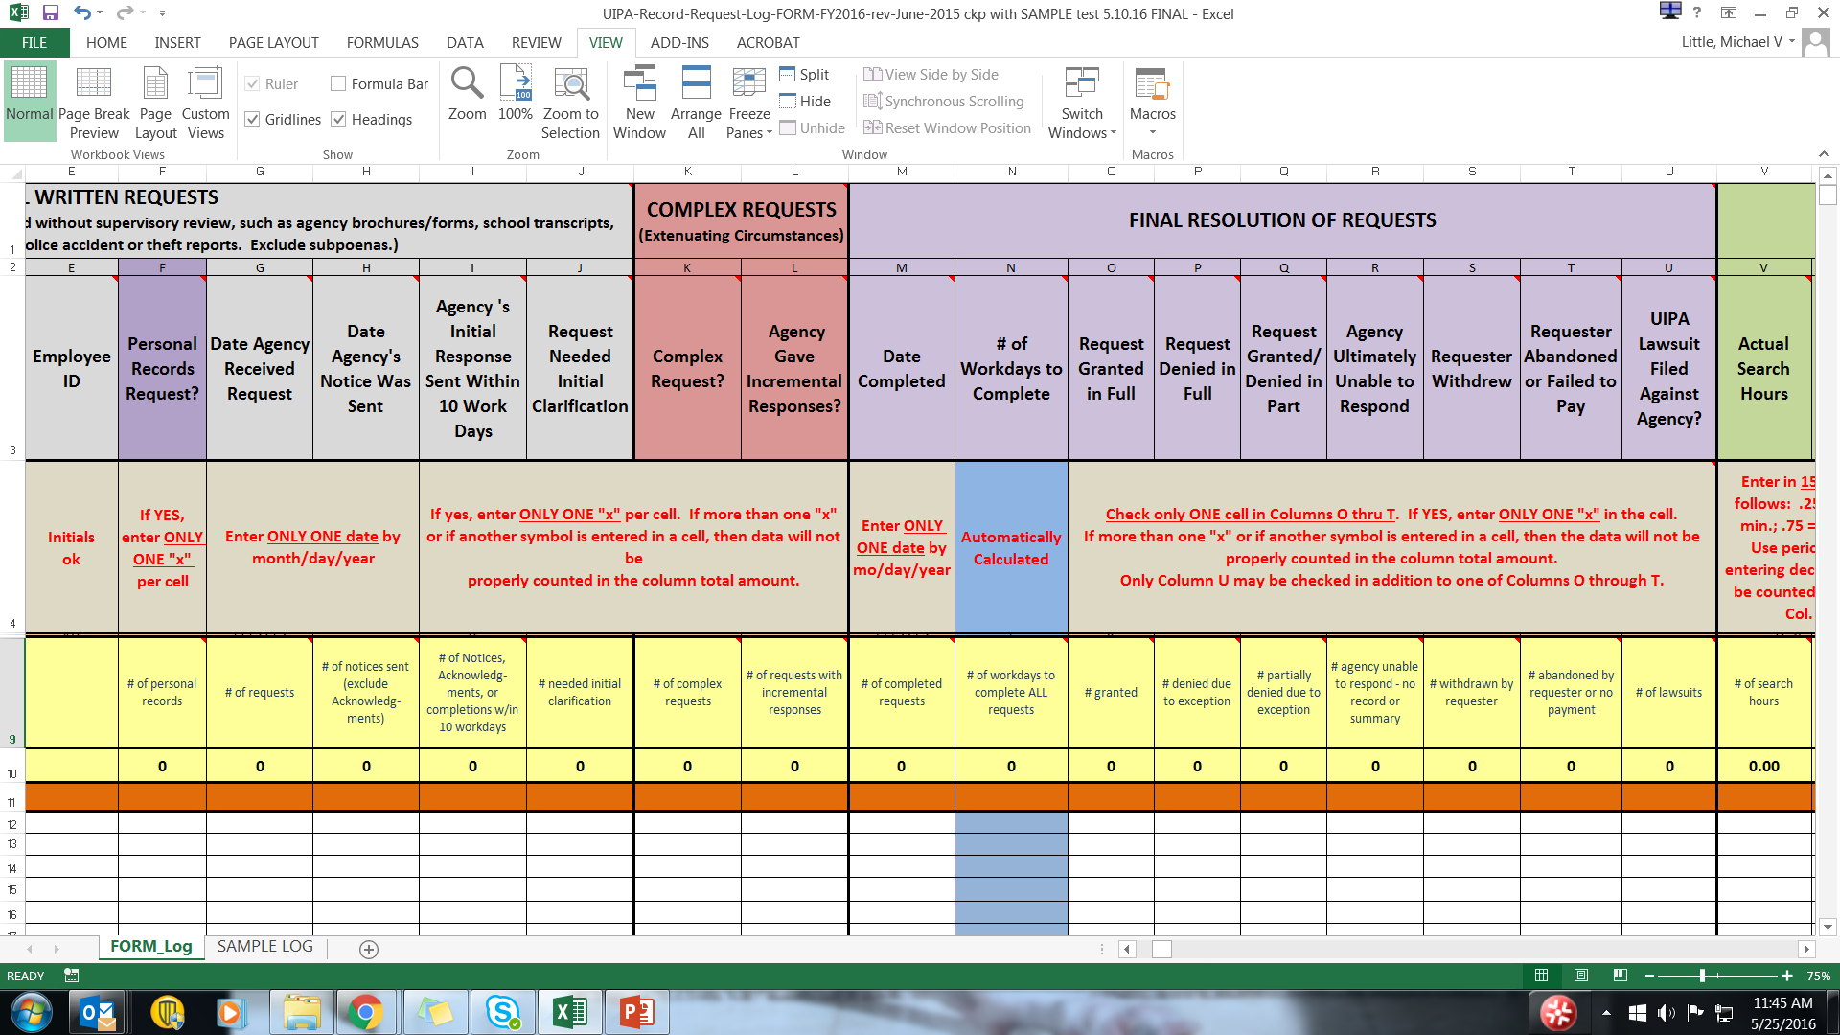
Checklist
#9 Complex requests
  Entered one “x” in column K if
  request involved extenuating
  circumstances or voluminous records.
  Also entered one “x” in column L if
  agency responded in increments.
Notes:
For Checklist item 9, again check to see that only one “x” was entered in Column K for a complex request involving extenuating circumstances or voluminous records.
Also check for only one “x” in Column L if the agency responded to the request in increments – there should not be any dates in Column L.

Slide 23
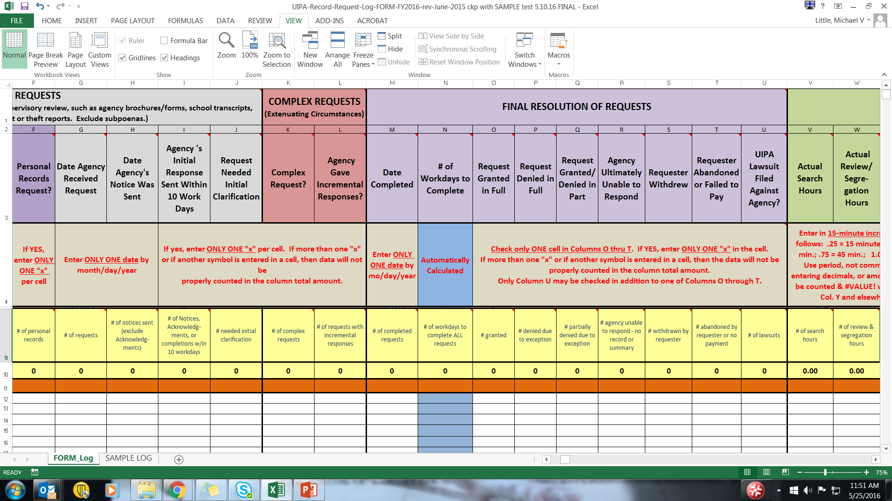
Checklist
#10 Date completed
  Entered the date (by month/day/year)
  that the agency made the records available or gave its final response to a request in column M.
  Each completed request has a number in column N that was automatically calculated (number of days to complete each request).
  There are no error messages or unexplainably high numbers in column N.
Notes:
Checklist item 10 asks about the completed date, which should be entered in Column M in the proper format by month/day/year.
The blue Column N will automatically calculate the number of days that it took the agency to complete the request and should not contain any error messages. If the number automatically calculated in Column N is unusually high, you should check to see if there were any errors in entering the dates of receipt or completion.

Slide 24
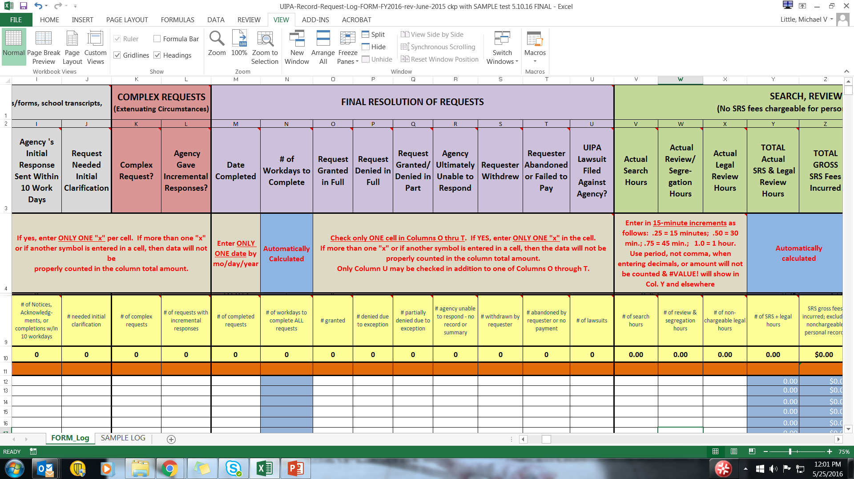
Checklist
#11 Final resolution
of requests:
  Each request has only one final outcome, so there is only one “x” entered between
  columns O through T.
Notes:
Checklist item 11 reminds you that there should be only one final outcome, so please check to make sure that there is only one “x” entered between columns O through T.

Slide 25
Checklist
#12 UIPA lawsuits:
  Entered one “x” in column U, if a UIPA lawsuit was filed by or against the agency during the reporting period for the Log.
Notes:
Checklist item 12 relates to Column U, which should be checked if a UIPA lawsuit concerning the request was filed either by or against the agency during the Log’s reporting period.
This is a change from previous years when the Log only asked if a lawsuit was filed against the agency. Although rare, it is possible that the agency could file a lawsuit concerning the request, so these should be tracked by the Log as well.

Slide 26
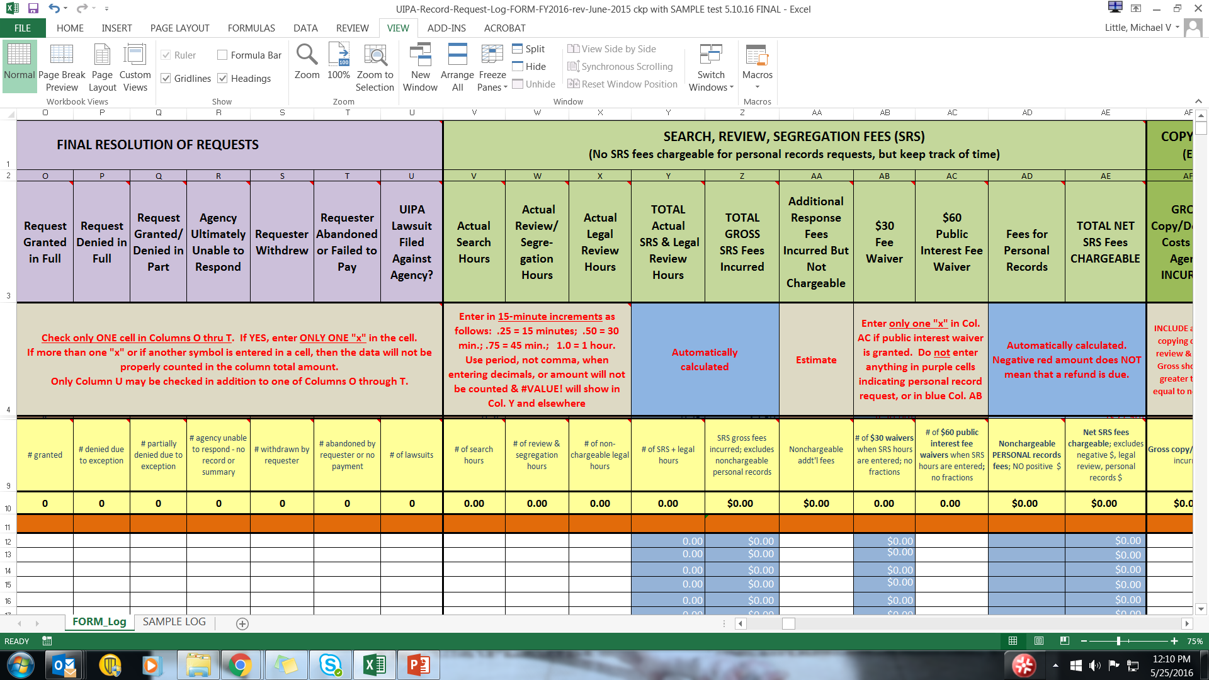
Checklist
#13 Search, review & segregation (SRS) and
legal review hours:
  Entered the hours in 15-minute increments (columns V, W, X); .25 = 15 minutes, .50 = 30 minutes, .75 = 45 minutes, 1.0 = 1 hour.
  At a minimum, .25 search hours was entered for every request that is granted in full or in part.
  Used periods, not commas, to enter the hours, so
  no error message #VALUE!
Notes:
Checklist item 13 asks you whether the search, review, and segregation (SRS) hours were properly entered in 15-minute increments and end in .25, .50, .75, or .00. At a minimum, at least .25 search hours, indicating 15 minutes, was entered for every request that is granted in full or in part.
If an error message #VALUE shows up on the Log, then it is probably because commas, not periods, were improperly used as the decimal point to enter the SRS hours.

Slide 27
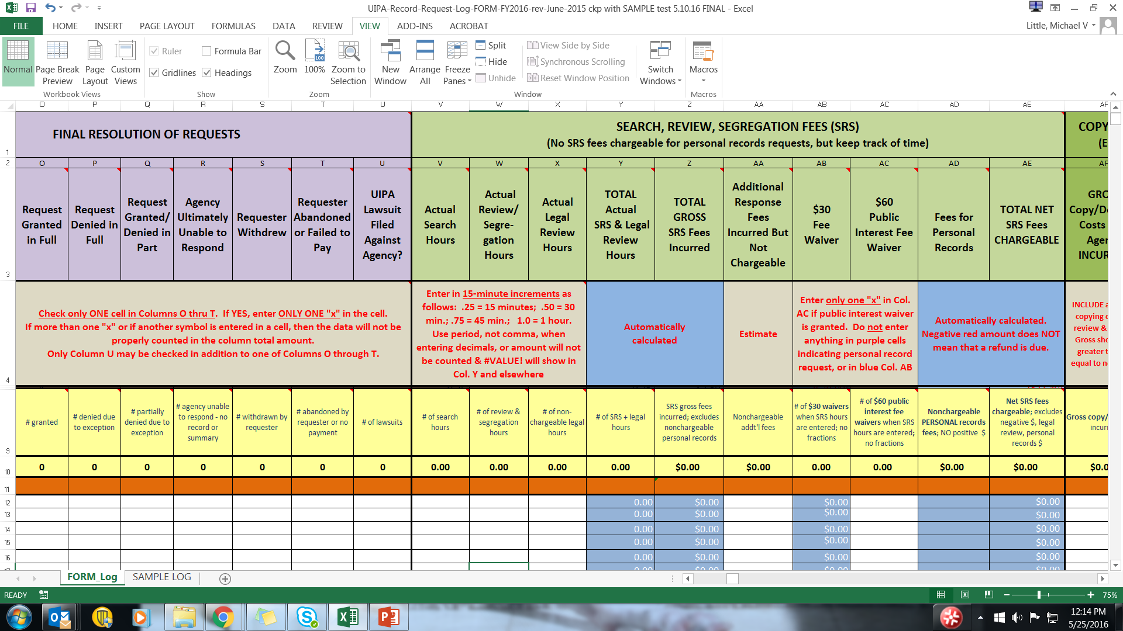
Checklist
#14 Additional response fees:
  Entered an estimated amount in column AA if non-chargeable fees were incurred to respond to a request, such as attorney fees or court costs.
Notes:
Checklist item 14 is a reminder that estimated amounts are entered in column AA if nonchargeable fees were incurred to respond to a request, such as attorney or witness fees and court costs.

Slide 28

Checklist
#15 Fee waivers
  Waivers only for fees, not costs
  Entered a negative ($30.00) in column
  AB for a $30 fee waiver OR a negative ($60.00) in column AC if a $60 public interest fee waiver was granted.
  Nothing manually entered in the purple colored boxes (indicating personal record requests)
  “Total” amounts in cells AB10 and AC10 have been automatically calculated as whole numbers, not fractions
Notes:
For FY 2016, Checklist item 15 asks you to check that fee waivers were properly entered by the agency. A negative ($30.00) in red and parentheses should show up in Column AB for $30 fee waivers. A negative ($60.00) in red and parentheses should show up in Column AC for a $60 public interest fee waiver. Nothing should be manually entered in the purple boxes indicating personal record requests since no fees may be charged for them.
If the “total” amounts in the yellow cells AB10 and AC10 are fractions, not whole numbers, then you know that a data entry error was made and will have to be corrected by the agency.

Slide 29
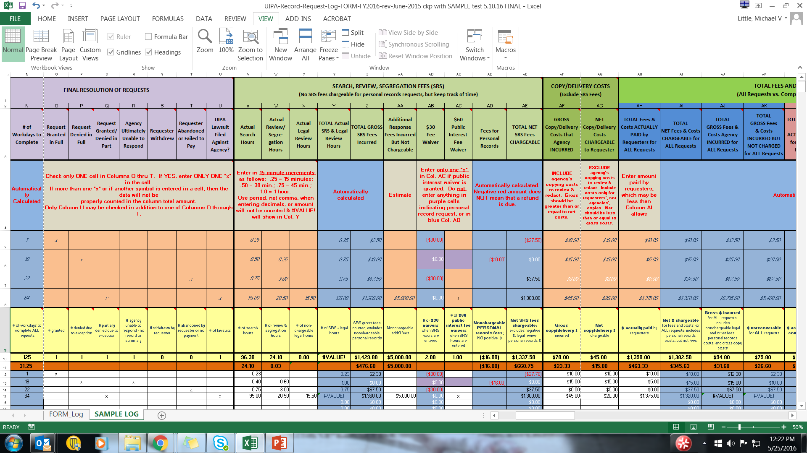
Checklist
Note: NEW in FY 2017
(for requests received 7/1/16 on)
  #15 Fee waivers:
    $30 fee waivers automatically
    displayed in column AB when SRS
    hours have been entered.
    Log automatically shows $0.00 in
    the purple colored boxes in columns
    AB and AC because no fee waivers are
    granted for personal record requests.
    Entered one “x” in column AC if a $60 public interest fee waiver was granted and SRS was conducted.
Notes:
The good news is that in FY 2017, the Log will automatically calculate the $30 fee waivers for you, which is why Column AB is now highlighted in blue – you don’t enter anything in this column. Also, you don’t enter anything in the purple cells, which indicate personal record requests for which no fees are charged or waivers granted.
You only have to enter a single “x” in the next column, AC, if the agency charges any SRS fees and grants a $60 public interest fee waiver.

Slide 30

Checklist
#16 Copy/delivery costs:
  The net chargeable copy and delivery costs in column AG do not exceed the gross incurred copy and delivery costs in column AF.
Notes:
For Checklist item 16, please ensure that the net chargeable costs entered by the agency in Column AG are equal to but not greater the gross incurred costs entered in Column AF. The net costs chargeable to the requester in Column AG should never exceed the gross costs incurred by the agency in Column AF.

Slide 31
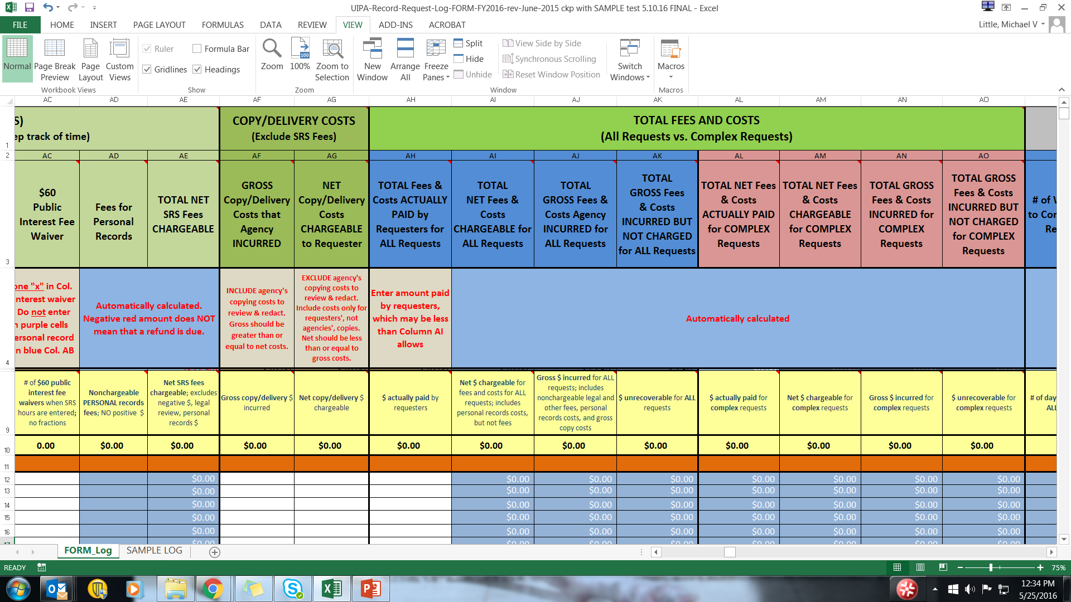
Checklist
#17 Total fees and costs
paid by requester:
  The amount actually paid by the Requester in column AH does not exceed the net fees and costs chargeable that the Log automatically calculated in Column AI.
Notes:
For the final Checklist item 17, please ensure that the amount actually paid by the requester that is entered in Column AH does not exceed the net fees and costs chargeable that the Log automatically calculated in Column AI.

Slide 32
Checklist
Instructions
  Before submitting to OIP your agency’s completed UIPA Record Request Log for FY 2016, please review the data entries, correct any data entry errors, and complete this checklist.
  Please submit your completed Log and Checklist to OIP (oip@hawaii.gov) by the January 31 and July 31 deadlines each year.
  OIP will upload your Log totals and routine requests estimate to the Master Log on data.hawaii.gov.
Notes:
After you have completed your agency’s Checklist and corrected data entry errors, please submit the Checklist and Log to your department’s UIPA Coordinator, who will then submit them to OIP.
The deadlines for submission to OIP are as follows:
For the year-end Log: by July 31
For the semiannual Log: by January 31
OIP will upload your agency’s Log totals and estimated number of routine requests onto the Master UIPA Record Request Log at data.hawaii.gov.
OIP will also summarize the year-end data in two reports, one for the state data and one for the county data. OIP’s reports for FY 2015 will be discussed in the next section of this training, so that you can see the results of your efforts in tracking your agency’s UIPA record requests. OIP’s intent is to familiarize you with the Reports and to show you how we used the data you collected. If you want to compare your agency to others, OIP invites you to print out or view the relevant Report online,.

Slide 33
Log Results – FY 2015
Chart 1:
Number of Requests to State Agencies:
Notes:
For FY 2015, OIP created two Reports – one for the State and another for the Counties – which summarize the data from their fiscal year-end Logs. The Reports are posted on the Reports page at oip.hawaii.gov. Today’s training will go over the charts that were created.
Chart 1 of the State Report shows that the 2,188 formal UIPA record requests logged by all state agencies in FY 2015 constituted only 2% of the record requests received by the State and that 98% were considered “routine requests” that were not logged.

Slide 34
Log Results – FY 2015
Chart 1:
Number of Requests to County Agencies:
Notes:
Similarly, Chart 1 of the Counties’ Report shows that the 1,515 record requests logged by all counties constituted only 3% of all requests and the remaining 97% were considered “routine requests.”

Slide 35
Log Results – FY 2015
  Table 1: Requests to County Agencies:
Formal Requests Routine Requests ALL_
Honolulu 1,026 (3%) 30,975 (97%) 32,001
Hawaii 243 (1%) 19,017 (99%) 19,260
Kauai 183 (7%) 2,590 (93%) 2,773
Maui 63 (100%) 0 (0%) 63
All Counties 1,515 (3%) 52,582 (97%) 54,097
Notes:
The Tables accompanying the charts in the Counties’ Report break down the data by each county, as seen in this slide of Table 1. Today’s training will not go through each county’s data, which you can view on your own in the Counties’ Report.
Since FY 2015 was the first time for the counties’ use of the Log, there are obvious discrepancies in data collection, which will hopefully be corrected after this training.

Slide 36
Log Results – FY 2015
Chart 2: State agencies
Notes:
Thanks to your efforts in identifying personal records requests by marking Column F of the Log and complex rrecord equests in Column K, OIP’s Reports can differentiate between different types of formal requests. Of the formal requests received by agencies during the fiscal year, Chart 2 illustrates the number of personal record requests, complex record requests, and the “typical” nonpersonal and noncomplex record requests received by the agencies.
This slide of Chart 2 of the State Report shows that 472 personal record requests constituted 21% of all requests received by state agencies; the 102 complex requests constituted 5%; and the remaining 1,614 “typical” requests that were not complex or for personal records constituted 74%.

Slide 37
Log Results – FY 2015
Chart 2: County agencies
Notes:
The Counties’ Report also shows the numbers and percentages of the different types of requests received by the counties. In FY 2015, it appears that only 12% of the counties’ requests were for personal records, as compared to 21% of state requests. The counties also logged twice as many complex requests (10%) compared to the 5% reported by state agencies. The 78% of typical county requests is similar to the 74% reported by the state.

Slide 38
Log Results – FY 2015
Chart 3A: State agencies
Notes:
In contrast to the requests that were received by the agencies, Chart 3A looks at the requests that were actually completed by the agencies during the fiscal year. Chart 3A also breaks down the completed requests according to their type. This chart is the result of your efforts in properly entering data in columns F, K, and M as to the types of requests and their completion dates.
Here, Chart 3A shows that of the 2,179 requests that the state agencies completed in FY 2015, 1,605 were “typical” requests, 472 were personal record requests, and 102 were complex record requests.

Slide 39
Log Results – FY 2015
Chart 3A: County agencies
Notes:
The Counties’ Chart 3A shows that they completed 1,427 total requests in FY 2015, of which 1,128 were typical requests, 160 were personal record requests, and 139 were complex requests.

Slide 40
Log Results – FY 2015
Chart 3B: State agencies
Notes:
Of all requests received by agencies, Chart 3B of the reports show you the number and percentage of record requests that were actually completed during the fiscal year. Because requests may be received up to the last day of the fiscal year, OIP gives agencies some additional time to complete those requests before submitting their Logs. Remember that the deadline for submission of agency Logs to OIP is July 31, and that your department may have an earlier deadline for submission of the Logs to the UIPA Coordinator.
Here, Chart 3B shows that the State completed an outstanding 99% of the 2,188 formal requests that it received in FY 2015, and that only 9 requests were not completed by the time that the Logs were submitted to OIP.

Slide 41
Log Results – FY 2015
Chart 3B: County agencies
Notes:
Chart 3B for the Counties shows that they completed 94% of the record requests that they received in FY 2015, and that 88 requests were not completed by the time the Logs were submitted to OIP.

Slide 42
Log Results – FY 2015
Chart 4: State agencies
Notes:
Chart 4 shows how the completed requests were resolved and is the result of your efforts in entering a single “x” in Columns O through T of the Log for each request.
In the State’s Report, the chart shows that 66% were granted in full; 14% granted or denied in part; and 4% denied in full. The state agencies were unable to respond to 12% of the requests and the requester withdrew, abandoned the request, or failed to pay in 4% of the cases.

Slide 43
Log Results – FY 2015
  Chart 4: County agencies
Notes:
For the Counties, Chart 4 shows that 73% of the FY 2015 requests were granted in full, 12% were granted or denied in part, and only 1% were denied in full. The county agencies were unable to respond in 12% of the requests and the requester withdrew, abandoned the request, or failed to pay in 7% of the cases.

Slide 44
Log Results – FY 2015
Chart 5: State agencies
Notes:
Chart 5 shows the average number of workdays taken to complete requests, as automatically calculated in Column N of the Log. This number is a little higher than it would be if it was manually calculated, because the Log’s calculations included the day of the request - otherwise, the calculation would have been zero days for requests that were completed on the same day they were received. The Log’s calculations excluded weekends, but they did not exclude state holidays. Thus, OIP estimates that the Log’s calculations have added an extra day or so to the averages.
Nevertheless, Chart 5 of the State Report shows that the agencies took an average of 8.1 work days to complete typical requests and 7.6 days to complete personal record requests, which are well within the 10 business days that the UIPA requires agencies to send out their initial Notices or Acknowledgements to Requesters. Complex requests took much longer for state agencies to complete – 21.3 days on average.

Slide 45
Log Results – FY 2015
Chart 5: County agencies
Notes:
For the Counties’ Report, Chart 5 similarly shows that it took an average of 8.3 days to complete the typical request and 7.1 days for personal record requests. The Counties’ average time to complete complex record requests was 13.4 days.

Slide 46
Log Results – FY 2015
Table 5: Each County’s agencies
Average Number of Workdays to Complete 1,427 Requests from Date of Receipt – by County
All “Typical” Personal Complex
Requests Requests Requests Requests
Honolulu 9.7 9.1 6.7 33.3
Hawaii 5.6 4.4 15.8 6.7
Kauai 6.1 2.5 6.3 12.8
Maui 12.9 13.1 4.0 (none)
All Counties 8.8 8.3 7.1 13.4
Notes:
As stated earlier, the Tables accompanying the Counties’ charts show the breakdown by each county. Table 5 shows how long, on average, it took each county to complete various types of requests in FY 2015, and county employees may want to more closely examine this Table on their own later.

Slide 47
Log Results – FY 2015
Chart 6: State agencies
Notes:
In responding to all requests, Chart 6 of the Reports show how many hours the agencies incurred for chargeable search, review, and segregation (SRS) time as well as for nonchargeable legal review time.
Overall, the State agencies incurred 3,441 total hours, including 448 hours for legal review.

Slide 48
Log Results – FY 2015
Chart 6: County agencies
Notes:
The Counties incurred 4,690 hours to respond to requests, including 51 legal review hours.

Slide 49
Log Results – FY 2015
Chart 7: State agencies
Notes:
Chart 7 excludes the nonchargeable legal review hours and differentiates between the search hours in blue and the review and segregation hours in yellow. It also shows the average number of chargeable SRS hours taken to complete different types of record requests. OIP was able to gather this information thanks to your efforts in entering your SRS and legal review hours in Columns V, W, and X of the Log, as well as in properly identifying the personal and complex requests.
What you will immediately notice in both the State and County charts is the big jump in SRS hours for complex record requests. Here is the State’s Chart 7, showing the complex record requests on the right.
Also, most of hours for the typical and personal record requests in the two bars middle of the Chart 7 are for search, as shown in blue, rather than for review and segregation as shown in yellow.
The average hours for all typical, personal, and complex requests is shown on bar at the far left.

Slide 50
Log Results – FY 2015
Chart 7: County agencies
Notes:
Here is the County’s Chart 7, similarly showing the big spike in hours spent on complex record requests on the right, and the hours for the typical and personal record requests in the middle, and the average on the far left.

Slide 51
Log Results – FY 2015
Chart 8A: State agencies
$37,603
fees &
costs
$37,820
fees
Notes:
Chart 8A of the Report shows on the left, the gross fees and costs that agencies incurred; in the middle bar, the net amounts that they could properly charge; and on the right, the actual amounts that they recovered in payment from requesters as shown in green. The first two bars show costs in yellow and fees in blue. This chart is based on the costs, fees, and waiver data that you entered between Columns AA and AH of the Log.
Chart 8A of the State Report shows that of the $79,423 in gross fees and costs incurred by state agencies, they recovered $37,603 from requesters, which is about half, but not quite enough to cover agencies’ gross costs of $41,603.

Slide 52
Log Results – FY 2015
Chart 8A: County agencies
$90,474
$70,438
fees
$12,745
$12,745
fees & costs
Notes:
The Counties Chart 8A shows they incurred $90,474 in gross fees and costs, and recovered only $12,745 from requesters, which did not cover their $20,036 in gross costs.

Slide 53
Log Results – FY 2015
Chart 8B: State agencies
$17,970
$15,071
$2,123
Notes:
Looking at the three bars on Chart 8B from left to right, you can see in red how much in gross fees and costs the agencies incurred for complex record requests, the net amounts in blue that they were permitted to charge, and the actual amounts paid in green by complex record requesters. You can see why it is so important for you to properly identify complex record requests and enter the other data, so that OIP can create these charts.
Here, you see Chart 8B for the State Report, which shows that of the $17,970 in gross fees and costs incurred by the State, only $2,123 was actually paid by complex record requesters.

Slide 54
Log Results – FY 2015
Chart 8B: County agencies
$30,121
$27,926
$3,381
Notes:
And here is Chart 8B for the Counties showing that $30,121 in gross fees and costs were incurred, and $3,381 was actually paid by complex record requesters.

Slide 55
Log Results – FY 2015
Chart 8C: State agencies
Notes:
Chart 8C excludes complex record requests and shows the gross and net fees and costs for typical and personal record requests and the amounts actually paid by those requesters. You can go back later and compare these costs to those shown in Chart 8B for complex record requests.
This is Chart 8C from the State Report.

Slide 56
Log Results – FY 2015
Chart 8C: County agencies
Notes:
Here is Chart 8C for the Counties.

Slide 57
Log Results – FY 2015
Chart 9: State agencies
Notes:
Chart 9 shows the number of fee waivers granted in cases completed by state agencies in FY 2015. The large dark blue slice on the right shows the number of 30% fee waivers, the small yellow slice on the bottom shows the number of $60 fee waivers, and the light blue slice on the left shows the number of requests where no fee waivers were granted.
Fee waivers will not be granted if the agency cannot respond to the requests or denies them in full. There may also be no fee waivers if the requester abandoned or withdrew the request. And no fee waivers are applicable for personal record requests since no fees can be charged in the first place, although costs may be charged.
OIP anticipates that the fee waiver errors that it has seen in the past will be corrected with the FY 2017 Log, which will automatically enter the $30 fee waiver in all non-personal record cases where any SRS hours have been entered, unless the agency enters an “x” in column AC to show that a $60 public interest fee waiver was granted.

Slide 58
Log Results – FY 2015
Chart 9: County agencies
NOTE: Fee waivers may not have been granted when requests are denied, abandoned, or withdrawn, or the agency is unable to respond.
Notes:
Here is Chart 9 showing the counties’ fee waivers.

Slide 59
Log Results – FY 2015
Chart 11: State agencies
Notes:
Moving on to Chart 11, this shows the numbers and percentages of requesters by amounts paid for completed cases.
As you can see from the State Chart, the largest blue portion shows that 88.5% of requesters in all cases completed in FY 2015 paid nothing at all. 5.7% of requesters paid up to $4.99 and another 3.9% paid between $5 to $49.99. Only 40 requesters – less than 2% - paid $50 or more in fees and costs.

Slide 60
Log Results – FY 2015
Chart 11: County agencies
Notes:
The County Chart 11 shows that 57.7% of the requesters in completed cases paid nothing. 24.7% paid up to $4.99 and 13.9% paid $5 to $49.99. 17.5%, or 51 requesters, paid $50 or more in fees and costs. No County requester paid $1,000 or more in fees and costs.

Slide 61
Log Results – FY 2015
Chart 12: State agencies
Notes:
Chart 12 breaks down in a different way the fees and costs paid for completed requests. The bar chart shows you the total amounts paid by requesters in various payment brackets. The average payment per bracket is calculated in the parentheticals below.
Since this State Chart 12 is more detailed and difficult to see, let’s look instead at the Counties’ Chart.

Slide 62
Log Results – FY 2015
Chart 12: County agencies
Notes:
This is Chart 12 for the Counties, which shows on the far left that 824 requesters paid zero for completed requests. Next to it, the short yellow bar shows that 353 completed requests were charged between $1 to $4.99 in fees and costs, for total payments of $653.75 and an average payment of $1.85 per request. The blue bar next to it shows that 199 completed requests were charged between $5 and $49.99, for total payments of $2,754.63 and an average of $13.84 per request. The chart continues on for three more payment brackets. Unlike the State, the payments to the Counties did not exceed $1,000 for any request, which is why two additional payment brackets were not included in this chart.

Slide 63
Log Results – FY 2015
Table 10: State agencies
TABLE 10: FY 2015 FEES & COSTS COLLECTED (by agency for completed requests)
DEPT | DIVISION/AGENCY | PERSONAL | AMOUNT COLLECTED | COMPLEX | AMOUNT COLLECTED | TYPICAL | AMOUNT COLLECTED
AG | AG | 0 | $ - | 0 | $ - | 9 | $ -
DOA | PIPQ | 0 | $ - | 3 | $ 107.20 | 5 | $ 12.50
DOA | ADC | 0 | $ - | 0 | $ - | 6 | $ -
DOA | AGRPIPEST | 0 | $ - | 0 | $ - | 27 | $ -
DOA | CHAIRPERSON | 0 | $ - | 2 | $ - | 2 | $ 5.49
Notes:
Charts 11 and 12 were created from data summarized in Table 10 attached to the end of each Report. Table 10 shows the fees and costs collected by each state or county agency, broken down into personal, complex, or typical requests.

Slide 64
Log Results – FY 2015
Table 10: State agencies
$0 | Under $5 | Amt | $5 to $49.99 | Amt | $50 to $99.99 | $100 to $499.99 | $500 to $999.99 | $1,000 & over
9
6 |  |  | 1 | $12.50 |  | 1
6
27
3 |  |  | 1 | $5.49
Notes:
Table 10 also shows the numbers of requests and total amounts paid within various brackets of payment amounts.

Slide 65
Log Results – FY 2015
Table 10: County agencies
TABLE 10: FY 2015 FEES & COSTS COLLECTED (by agency for completed requests)
COUNTY | DEPARTMENT | PERSONAL | AMOUNT COLLECTED | COMPLEX | AMOUNT COLLECTED | TYPICAL | AMOUNT COLLECTED
ALL COUNTIES TOTALS |  | 160 | $1,572.51 | 139 | $3,381.33 | 1,128 | $7,778.97
Percentage of 1,427 requests |  | 11% |  | 10% |  | 79%
TOTAL PAID $12,745
Notes:
Table 10 for the Counties’ Report is grouped by county and gives each county’s subtotaled amounts as well as all counties’ total amounts.

Slide 66
Log Results – FY 2015
Table 10 Supplement: Summary of Fees and Costs Paid by Requesters – State agencies
Over $10,000:
* 1. DOT/ HIWAYS – Experian Information Solutions - $12,796.96
* 2. DOT/ HIWAYS – RL Polk - $12,796.96
TOTAL = $25,593.92
$1,000 - $9,999.99
* 1. OHA – Andrew Walden (media) - $1,647.75
TOTAL = $1,647.75
* Appears to be a request from an attorney, media, commercial or non-profit organization.
Notes:
In the Table 10 Supplement, OIP created a summary of the fees and costs totaling $50 or more that was paid by requesters. If the requester appeared to represent media, law firms, insurance companies, or other commercial or nonprofit organizations, then OIP added an asterisk before their names. This gives us a better idea of who is paying for the larger fees and costs, specifically whether they are individuals versus businesses or non-profit organizations.
Using a very rough methodology, OIP estimated that 28 of the 40 requesters paying state agencies $50 or more in fees and costs in FY 2015 were commercial or nonprofit entities. Similarly, in the County’s Table 10 Supplement, it appeared that 41 of the 51 highest paying requesters were entities, not individuals.
With the FY 2017 Log, OIP would like to improve the data gathering process by asking the agencies to identify requesters in Column D with an asterisk if they appear to represent for-profit or non-profit organizations, including businesses, law firms, insurance companies, newspaper/TV/radio stations, or other commercial entities or advocacy groups.

Slide 67
Log Results – FY 2015
Table 10 Supplement: Summary of Fees and Costs Paid by Requesters – State agencies
TOTAL paid by requesters $50+ = 36,075.67
Plus total paid by requesters $5 to $49.99 = 1,324.86
Plus total paid by requesters under $5 = 203.34
TOTAL paid for all requests = $37,603.87
Notes:
Finally, in the Table 10 Supplement, OIP has calculated the total dollar amounts paid by requesters, grouped into three payment brackets.
This slide shows the amounts found in the State‘s Table 10 Supplement, which shows that most of all payments from requesters were made by those paying $50 or more, which we know from earlier Charts 11 and 12 numbered 40 requesters.

Slide 68
Log Results – FY 2015
Table 10 Supplement: Summary of Fees and Costs Paid by Requesters - Counties
TOTAL paid by requesters $50+ = $ 9,336.93
Plus total paid by requesters $5 to $49.99 = 2,754.63
Plus total paid by requesters under $5 = 653.75
TOTAL paid for all requests = $12,745.31
Notes:
Here are the totals from the Counties’ Table 10 Supplement.

Slide 69
MAHALO!
Notes:
In closing, OIP extends a hearty MAHALO to all state and county employees who have tracked or reviewed record requests, gathered the Logs, and provided the data that OIP needed to create its State and County Reports. Your logging efforts provide objective data that OIP can use in preparing revisions to its administrative rules, which it will begin reviewing in FY 2017.
OIP hopes that you, too, have realized the benefits of using the Log to track record requests and respond in a proper and timely manner.
Together, our efforts will enhance government transparency and accountability and provide better service to the public. MAHALO NUI LOA!

Slide 70


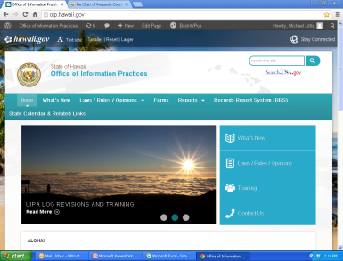
Need Help?
Call OIP (808) 586-1400
E-mail: oip@hawaii.gov
OIP website:
oip.hawaii.gov
Notes:
If you need any help, please feel free to check OIP’s website at oip.hawaii.gov, or contact OIP by calling (808) 586-1400 or emailing oip@hawaii.gov.
OIP welcomes your comments on this training. Once again, thank you for attending and for your work in protecting the public’s right to open records and government transparency.

